Slide 1
Developing Reinforcement Learning Algorithms for Robots to Aim and Pour Solid Objects
Thesis Defense
Haoxuan Li
Major professor: Yu Sun, Ph.D.
Shaun Canavan, Ph.D.
Yasin Yilmaz, Ph.D.
Present date: March 4, 2022
Notes:
Hi everyone, My name is Haoxuan Li, welcome to my thesis defense. we have Dr. Sun, my major professor, Dr. Canavan and Dr. Yilmaz as my committee members. It is my honor to have you here. Today I am going to present my study in robotic manipulation and deep learning. The title of my research is xxx.

Slide 2
Agenda
Introduction
Background
Related Work
Purpose of the Study
Problem Formulation
Methodology
Implementation
Training Performance
Evaluation
Conclusion
Limitation and Future Development
Introduction(2~4)
Conclusion(37,38)
Questions
Result(28~36)
Objective(5~8)
Method(9~27)
Notes:
In today’s presentation, we will cover the follow topics. I convert them into the progress bar to help you locate the sections
Feel free to ask if you have any question.

Slide 3
Background
Pouring is the most common practice in our lives[1], it is also a major topic in robotic research
Most of the existing works focus on pouring the exact amount
Accommodations are made for spillage
More attention on liquid and liquid-like objects
Solid objects are harder to manipulate
Aggressive collision
High granularity
Static friction
Introduction(2~4)
Conclusion(37,38)
Questions
Result(28~36)
Objective(5~8)
Method(9~27)
Notes:
Pouring as been a hot topic in robotic manipulation. Based on the dataset collected by our lab, it is the most common practice in our lives. However, most of the prior studies focus on pouring liquid. There is very a limited attention paid to spillage avoidance. Frequently, people set up a pouring position by hand or use larger containers as the accommodation.
Besides spillage, solid objects also earn fewer eyeballs. Because it is harder to learn the dynamics of solid objects like cubes. The collision between objects can cause unpredictable trajectories. For instance, when an object land in the container, it will bounce off. The final location is uncertain. Also, the static friction may prevent objects from moving. Therefore, pouring solid objects remains a challenge.

Slide 4
Related Work
USF Robot Perception and Action Lab (RPAL)
Using functional analysis and dynamic time warping to generate manipulation trajectory [2]
Using LSTMs to predict future volume and model predictive control (MPC) to control movement [3]
Using LSTMs and Learning from Demonstrations (LfD) to learn the movement and generalization by self-supervised practicing (GSSP) to improve data efficiency [4]
GSSP: uses the actual outcomes instead of the desired outcomes to fine-tune the model.
Do et al. utilized Deep Deterministic Policy Gradient (DDPG) [5] to pour liquid
Mordi et al. used Soft Actor-Critic (SAC) with approximated reward to pour spheres [6]
Introduction(2~4)
Conclusion(37,38)
Questions
Result(28~36)
Objective(5~8)
Method(9~27)
Notes:
There are extensive works have been conducted in our lab related to pouring, here we just select a few of them to see how we tackled the pouring problem through the years. Researchers had proposed many different solutions, such as functional analysis, combining recurrent neural networks with MPC or imitation learning. They were able to achieve outstanding results for pouring liquid.
But RNN is not the best choice for pouring solid objects. it becomes less reliable due to the memory issue and it is hard for RNN to learn complicated dynamics. We start to look into RL, such that the agents can solve the tasks without learning the dynamics. In do’s team, DDPG is used to control the rotation speed as well as the pose of the end-effector. Mordi’s team proposed to use SAC to pour spheres. Agents will learn the hidden states to represent the pouring progress and output the corresponding actions.
Only Mordi’s team used solid objects. However, the property of sphere is very similar to liquid. In fact, they set the radius of the spheres small in order to mimic liquid’s behavior.
There is less attention paid to pour mid-size solid objects and avoid spillage. but we often pour things like ice cube, diced fruit in real life and we don’t want them to land outside of the container. Thus, It is a topic that is worthy of more focus.

Slide 5
Purpose of the Study
Control the robotic arm to aim and pour solid objects into the target container
Introduction(2~4)
Conclusion(37,38)
Questions
Result(28~36)
Objective(5~8)
Method(9~27)
Notes:
The goal of our study is to find a way to control

Slide 6
Problem Formulation
Further divide the problem into
Visual aided models
Non-visual models
Rationale of non-visual models:
Visual inputs are not reliable in real life
Processing images is relatively slow
Pouring content: cuboid
Aggressive collision
Rigid movement due to flat surface and static friction
Introduction(2~4)
Conclusion(37,38)
Questions
Result(28~36)
Objective(5~8)
Method(9~27)
Notes:
To solve the problem, we first divide it further into visual and non-visual models. The intuition of trying to pour without visual input is if we can train a model that doesn’t rely on vision sensors, the performance will be more robust. Because There are many constraints in real life when we use vision sensors, such as lighting, positioning, etc.
For pouring contents, we choose to use cuboid, this primitive can give us aggressive collisions because it has a larger surface areas compared to cylinder and sphere. The movement of cuboids is also harder to control, because static friction applied on the flat surface are larger than other shapes. By solving this difficult configuration, we can easily transfer to other shapes in the future.

Slide 7
Problem Formulation-cont
We define the pouring problem as a Markov decision process (MDP)
M = (S, A, P, R, γ)
S: a set of states
End-effector’s pose: (y, z)
Pouring content’s location
A: a set of actions (continuous or discrete)
End-effector’s horizontal and vertical displacement: Δy, Δz
Changes in end-effector’s rotation velocity: Δω
P: a deterministic transition probability
R: reward
γ: reward discount factor
Introduction(2~4)
Conclusion(37,38)
Questions
Result(28~36)
Objective(5~8)
Method(9~27)
Notes:
We address the problem as an MDP, which is a framework for modeling decision making . In this slide we will define the tuple for MDP.
S is the set of states. It contains the end-effector’s pose and objects location. For the location, we are not using coordinates. Because it is expensive to maintain a list of coordinates of all the objects in the pouring scene. Instead, we use hidden layers to learn the representation.
A is the set of action. It can be either continuous or discrete.
Continuous means the value of the actions can be any real numbers within a certain interval. Discrete means agents can only select predefine actions. The actions are displacements in the y and z axis and also the change in the end-effector’s rotation velocity
As you can see we only have a 2D coordinate system here, we limit the linear action space to a vertical plane. It allows the robot to move the pouring cup up-and-down and forward and backward, which is sufficient for aiming. We define the z axis as the vertical axis and the y axis as the horizontal one.
P is the transition function that describe the probability of state s transit to the next state s prime when taking action a. Here we have a deterministic function because everything can be calculated using inverse kinematics.
R is the reward
Gamma is the discount factor controlling for a trade-off between immediate and future rewards.

Slide 8
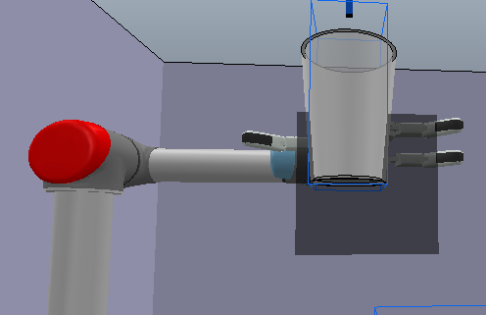
Bounded Workspace
Insight: good pouring positions should be close to the target
Prevent meaningless exploration
Speed up convergence
20cm x 20cm movement perimeter in the yz plane
Limit each action’s magnitude to [-0.1,0.1]
Prevent sudden movement
Encourage smooth trajectories
Introduction(2~4)
Conclusion(37,38)
Questions
Result(28~36)
Objective(5~8)
Method(9~27)
Notes:
we limit the movement in the yz plane even more. The center of the cup can only move within this perimeter.
The insight of having it is: xxxxx, it doesn’t contribute to solving the task if the robot stays 1m away from the target. With this perimeter, our agents can converge faster
We also shrink the magnitude of actions in order to Prevent sudden movement. We will see detail settings in later slides.
Any questions so far?

Slide 9
Reinforcement Learning in Pouring
Continuous action space:
DDPG[8]
Twin Delayed Deep Deterministic Policy Gradients (TD3) [9]
Discrete action space:
Double-DQN [10]
Introduction(2~4)
Conclusion(37,38)
Questions
Result(28~36)
Objective(5~8)
Method(9~27)
Notes:
For continuous xxxxx as our underlying algorithms. They are in the actor-critic family.
we use DDQN for discrete action space

Slide 10
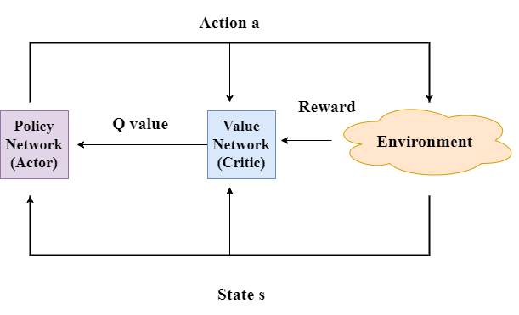
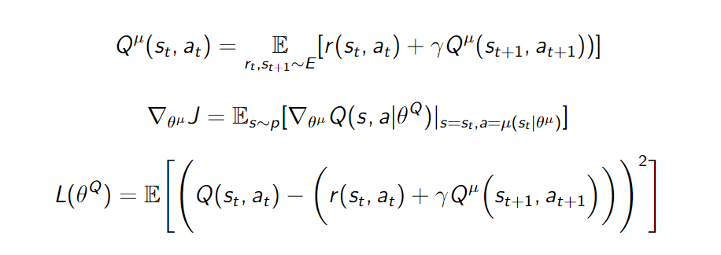
(1)
(2)
(3)
Introduction(2~4)
Conclusion(37,38)
Questions
Result(28~36)
Objective(5~8)
Method(9~27)
Notes:
The Actor-Critic system is the combination of the policy network and the value network. Double-DQN only contains the value network.
The value network produces the judgement or Q value based on the input given at time t, which is represented by equation 1. Q values are used to evaluate how good a state action pare is. For double DQN, the q value will be used to select predefine actions.
To update network’s weight, we use equation 2 and 3
the policy network will use the Q value as the loss to perform gradient ascent
To update value network’s weight, we use TD learning. where we calculate the TD target, it is an approximation of the future reward. We use the difference between the approximation and actual observation as the loss to perform gradient descend.

Slide 11
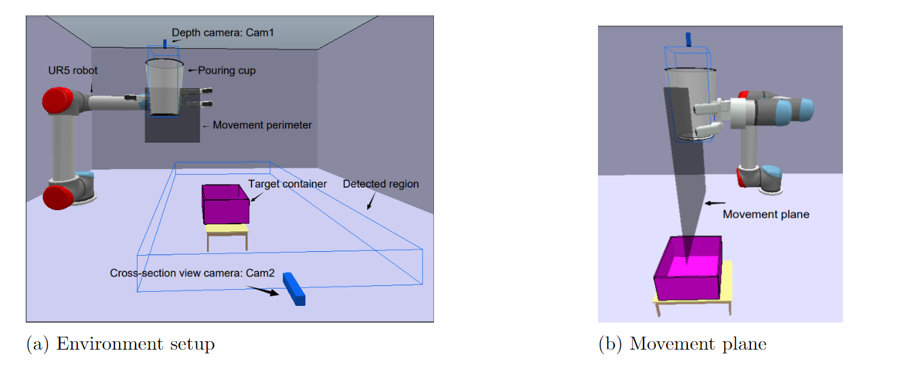
Environment Setup
Introduction(2~4)
Conclusion(37,38)
Questions
Result(28~36)
Objective(5~8)
Method(9~27)
Notes:
Now we are going to introduce the setup.
The pouring scene is built in coppelia simulator. The size of the objects are similar to what we have in real life. As you can see, we have the UR5 robot arm holding and the cup. The cup will rotate with the hand. There are also two vision sensors cam1 and cam2. Detail of the vision sensors will be given in the later slides. The target is the purple box. the agents will pour everything out from the pouring cup to this purple box. The cup will rotate cw in order to pour into the target. The clockwise rotation has a negative velocity.
The two joints marked in red are used for the pose randomization. They will have a random rotation at the beginning of each episode to generate different starting positions.
the movement perimeter is marked by the black square, The center of the perimeter is placed 10 cm lower and to the right relative to the source cup. And the side length is 20cm. We pick this setup based on our experience
*******
Remember we limit our motion range in 2D, also shown in figure b, these two joints are the closest to the base that move in yz plane. Moving these base joints can give us a larger range of randomization of the end-effector’s position.

Slide 12
Visual Models
Overview
Observation and Action Space
Reward
Architecture
Non-visual Models
Overview
Observation and Action Space
Reward
Architecture
Introduction(2~4)
Conclusion(37,38)
Questions
Result(28~36)
Objective(5~8)
Method(9~27)
Notes:
For the following 11 slides, we will discuss the setup of our models. We will start with visual models
Coming back: now we are going to introduce ….
Next, is the
We have talk about … let move to
For the last part of xx models, we have look at the architecture
Finally, we will check the architecture of xx model

Slide 13
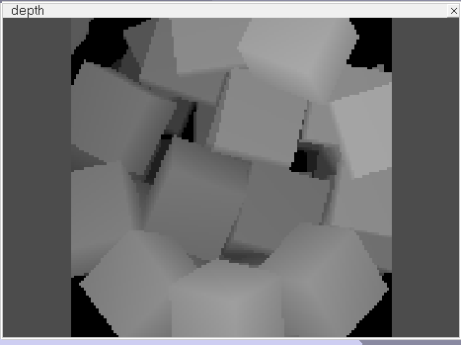
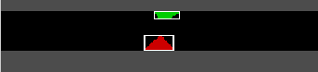
Visual Aided Models
Visual option 1: depth map
Camera looks into the source cup
Returns structural information of the objects in the cup
aka Cam1
Visual option 2: cross-section view
Camera looks from the side
Returns bounding boxes if detected anything
aka Cam2
Output: △y, △z, △ω
Introduction(2~4)
Conclusion(37,38)
Questions
Result(28~36)
Objective(5~8)
Method(9~27)
Notes:
For visual models. There are 2 types of inputs. First is depth map, the camera will return the depth info about the pouring content in the source container. We call this cam1. It will return a 128*128 image, then we perform an average pooling to resize it to a 16*16 array.
The second one is a side-view RGB camera. We choose to only return a cross-section because we don’t want to introduce irrelevant pixels to the models. The center of the view is aligned with the target container’s center. If there are objects falling through, the camera will return a bounding box with the objects location in the camera coordinate. We divide the image into 7 sections horizontally. Each section will have a value scaled from 0 to 1, where 0 means no bounding box is detected in the slot meaning no object there, and 1 means the bounding box’s width is greater than or equal to the section length.
As shown in the image, the two blocks here are very likely to land in the target. And the value of the middle section should be 1.
Visual models will output 3 values.

Slide 14
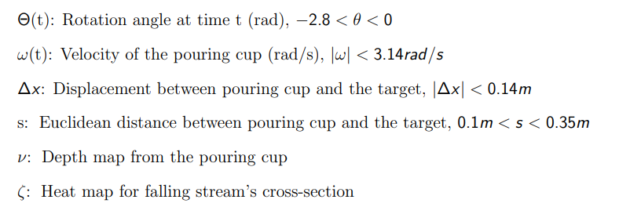
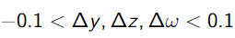
Observations
Actions
, 256-element 1D array
, 7-element 1D array
Introduction(2~4)
Conclusion(37,38)
Questions
Result(28~36)
Objective(5~8)
Method(9~27)
Notes:
There are 6 elements in the observations. The rotation angle is limited to -2.8,0. where 0 is the initial position of the end-effector, -2.8 is the maximum rotation angle. Remember we define clockwise rotation velocity to be negative. And because the target is located in the lower right relative to the source cup, we want the arm to rotate only clockwise. Therefore no positive value for theta.
The intervals for delta x and distance s are calculated based on our set up.
The initial rotation velocity is set to be -0.4 rad/s.
The elements in observations will be updated every step and agents will use that to produce Q values and actions

Slide 15
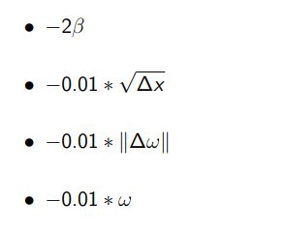
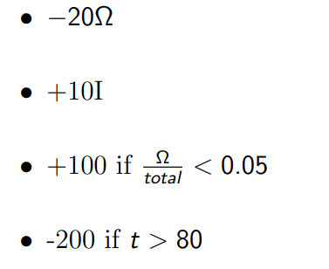
Rewards for Visual Models
Movement phase: Settlement phase:
β: attempts of moving outside of the perimeter
Ω: number of outliers
I: number of objects land in the target
Introduction(2~4)
Conclusion(37,38)
Questions
Result(28~36)
Objective(5~8)
Method(9~27)
Notes:
There are two phases in pouring, settlement and movement phase. As indicated by their names, The movement reward is calculated every step while the settlement phase’s rewards will only be calculated once after the episode is terminated.
movement phase contains our secondary goal, it teaches the model how to obtain a smooth and efficient trajectory. each parameter will be updated at the beginning of each step and do not accumulate. The first term is used to punish attempts of moving out of the perimeter. For each attempt on each axis, we give it a -2 punishment. The middle two are used to punish aggressive changes. The last term encourages clockwise rotation and punishes counter-clockwise rotation so that the pouring can be finished asap.
For settlement phase, we encourage the agents to pour as many objects into the target as possible, which is our primary goal . For each object that is out of the container, we give a -20 punishment. For each that is in the container, agents will receive a positive 10 reward. If the number of outlier is less than 5% of the pouring content, agents will get a 100 bonus. Finally we have the timeout penalty, to avoid endless episode

Slide 16
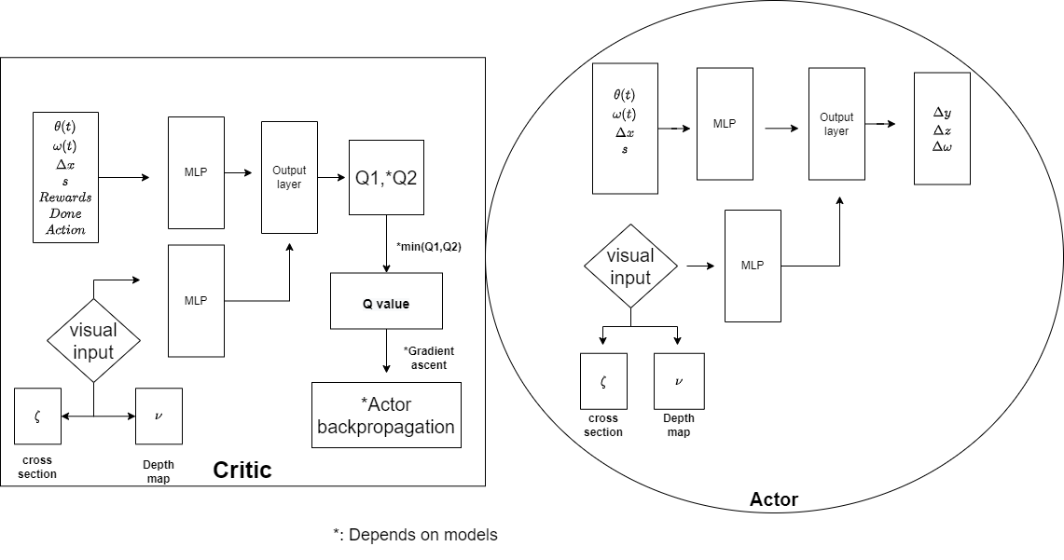
Introduction(2~4)
Conclusion(37,38)
Questions
Result(28~36)
Objective(5~8)
Method(9~27)
Notes:
Here is the architecture for visual models. Agents can choose to only use cam1, or cam2, or it can use both. For TD3 and DDPG, they have both critic and actor. the q value will be used as the actor’s gradient for back propagation. But for DDQN, it will only have the critic and one q value. The q value for DDQN will be used to select action because there is no actors in DDQN.
The second Q value is only produced by TD3. There is a twin critic system in TD3, it will output 2 Q values and select the smaller one to avoid overestimation.

Slide 17
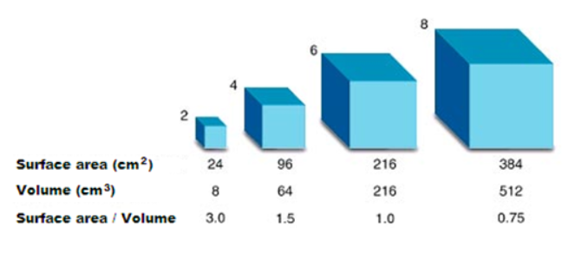
Surface to Volume Ratio
Cross-section view camera doesn’t return structural information
Offer surface to volume ratio к for compensation
Introduction(2~4)
Conclusion(37,38)
Questions
Result(28~36)
Objective(5~8)
Method(9~27)
Notes:
We notice that when using cam2 alone, which is the cross-section view camera, it doesn’t have the knowledge of the object’s shape. The bounding box detection algorithm only return rectangles. Unlike using cam1, the depth information give some hints of the shapes.
Therefore, to represent the structural information without using another vision sensor, we introduce kappa, the surface to volume ratio

Slide 18
Structural Encoding Model
Use object related property to reduce bias in the weights
Provide more non-visual resources to help the agents make strong prediction
Apply it on the actors from TD3 agents
Reduce the risk of overfitting in critics
TD3 is stable
Introduction(2~4)
Conclusion(37,38)
Questions
Result(28~36)
Objective(5~8)
Method(9~27)
Notes:
We will use 2 fully connected layers to learn the representation. The output of the MLP will be fed to the actor because our critics already have a complex input space and our network is relatively simple By feeding it to the actor we reduce the risk of overfitting the critics.
We apply this change only to TD3 agents. Because it is the only algorithm that is able to solve the task with a consistent performance. Therefore, we want to have a stable baseline to better compare our implementation.
We give a new name to this model, called structural encoding
******
In addition, because in the actor-critic system, their losses are connected such that the output of the critic is the gradient of the actor, and actor’s output will result in a new state and new reward, in which the critic will perform TD learning to calculate the loss, information within the system will propagate like a ripple. Even though we feed kappa to the actors, the information will reach critics eventually.

Slide 19
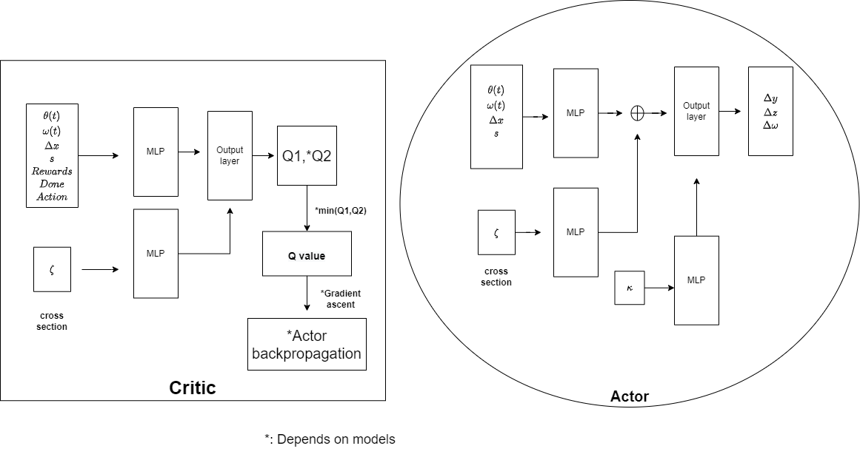
Introduction(2~4)
Conclusion(37,38)
Questions
Result(28~36)
Objective(5~8)
Method(9~27)
Notes:
This slide shows the architecture of structural encoding models. We use two fully connected layers to learn the representation of the kappa. The layers for processing kappa is smaller than the one processing states. The output of the MLP should represent what content is being poured and it is combined with the hidden states that represent the observation before the final activation function. We basically skip neurons like resnet does.
Since kappa is not one of the observation, we separate it from them. In addition, kappa doesn’t change at each step, it only change once per episode, therefore, feeding it separately also help the agents to focus on the right thing. There will be one network processing the observation while the other one giving instructions on how to deal with objects in different sizes.
******
Since the whole RL algorithm is just a functional approximation of the pouring dynamics, what we did is introducing a meaningful bias to the equitation, and teach the model to act differently when seeing different objects

Slide 20
Non-visual Models
Four stages
Spawn stage: randomly generate objects and initialize the pose
Ready stage: move arm to an optimal position before pouring
Intermediate stage: rotate the cup
Final stage: pouring is finished
S: a set of states
End-effector’s pose: (y, z)
A: a set of actions (continuous or discrete)
End-effector’s horizontal and vertical displacement: Δy, Δz
Introduction(2~4)
Conclusion(37,38)
Questions
Result(28~36)
Objective(5~8)
Method(9~27)
Notes:
For non-visual models, we have different setups. The model only outputs the displacement on yz axis. To better understand why the change happens, we define the four stages in pouring. During spawn stage, pouring contents and pose will be initialized. The arm will move to the optimal position before rotation starts during the ready stage. Intermediate stage simply rotates the cup until final stage is triggered.
Due to the lack of visual information, we are not able to correctly identify the location of the pouring contents once they leave the cup. Since the primary reward is calculated based on the location of the objects. Our actions don’t connect the reward to our observation.
The goal of the task is now finding the optimal ready position. We can compare it to a maze problem. When agents trying to find the way out, they don’t know where the exit is or what is the best path. However, after entering the maze for enough times the agents will find a way out. That is very similar to what we are doing here. The agents will try to find the optimal ready position, and pour from there.
The set of states now only contains the poses. Because of this, we change the actions space in order to match with the states space.

Slide 21
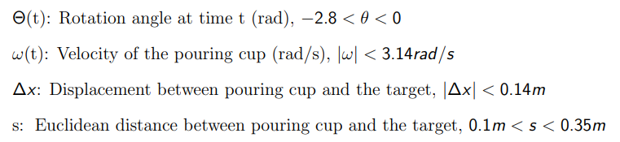
Observations
Actions
(Δy, Δz), where -0.1 < Δy, Δz <0.1
Introduction(2~4)
Conclusion(37,38)
Questions
Result(28~36)
Objective(5~8)
Method(9~27)
Notes:
The observation spaces are the almost the same expect for the removal of visual information
Actions only contain the displacement. The rotation speed now is fixed to -0.4 rad/s

Slide 22
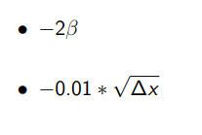
Rewards for Non-visual Models
Movement phase: Settlement phase:
Introduction(2~4)
Conclusion(37,38)
Questions
Result(28~36)
Objective(5~8)
Method(9~27)
Notes:
Since we fix the rotation speed for this model, our movement phase only contains the smooth cost, to teach the agents to move smoothly and efficiently to the optimal ready position. The settlement phase is the same as before
Any questions for far?

Slide 23
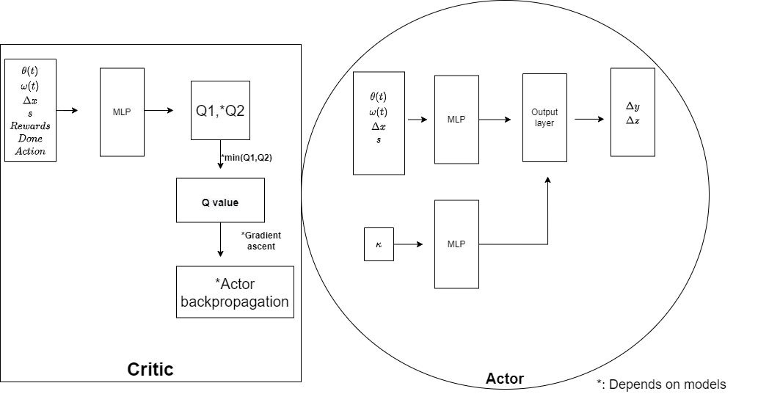
Introduction(2~4)
Conclusion(37,38)
Questions
Result(28~36)
Objective(5~8)
Method(9~27)
Notes:
The biggest changes is the removal of visual components, also the new output space.
To compensate the lack of visual information, we also include kappa here. It serves the same purpose as in structural encoding models.
We conduct an ablation study on kappa. For models that don’t use kappa, we remove the lower part

Slide 24
Models Summary
Visual models
Using depth map, aka Cam1 model
Using cross-section view, aka Cam2 model
Using both depth map and cross-section view, aka Cam1+Cam2 model
Using cross-section view + к regularization, aka Structural Encoding
Non-visual models
Using к
Use only primitive observation
Introduction(2~4)
Conclusion(37,38)
Questions
Result(28~36)
Objective(5~8)
Method(9~27)
Notes:
There are lots of models we just went through, here is a quick summary.
We have 4 models in visual setting, 2 in non-visual. Abbreviations are shown next to each model.

Slide 25
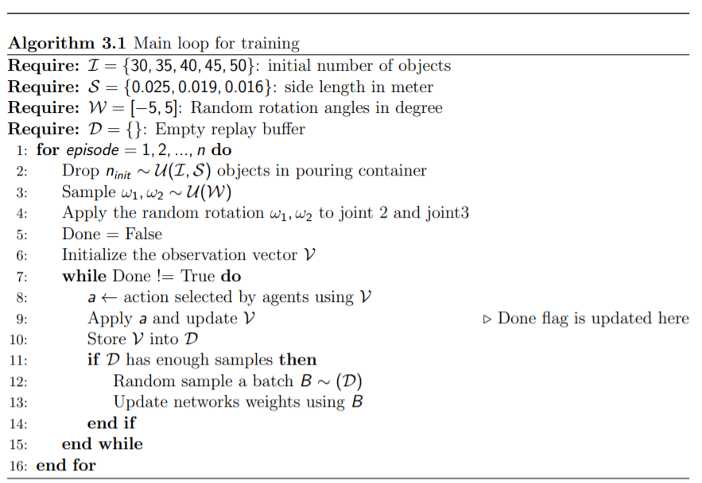
Notes:
Now let’s look at a general training procedure.
In each episode, we will randomize the object’s amount as well as the size. We also set a random starting pose.
At each step within the episode, the agents will use the most recent observation stored in the observation vector V to select actions . Then we call the step function to execute the action. All the MDP elements are stored in the replay buffer for TD learning and better data efficiency.

Slide 26
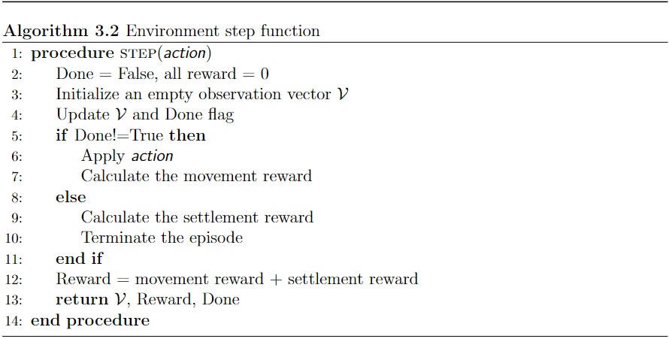
Notes:
The step function executes the action and collects new observations. Each step is the composition of 10 frames in Coppelia. A step will start with the end-effector in its original position, end when it arrives at the target position. This technique forces our agents to make the most efficient choice at each step. It lowers the requirement of communication bandwidth and input precision and contributes to a more robust model.
Before executing the action, v and done flag will be updated. if the cup has rotated more than 100 deg or the force sensor reading suggests there is nothing left in the pouring cup, we will set the flag to true.
If the pouring is not finished, we will execute the action and get the movement reward, otherwise we calculate the settlement phase reward.

Slide 27
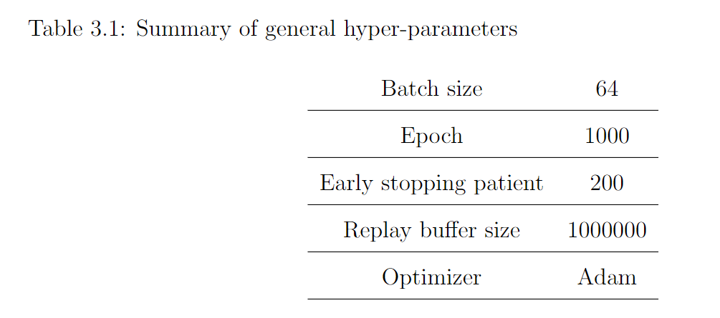
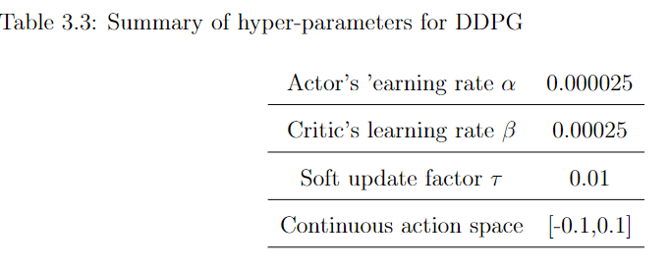
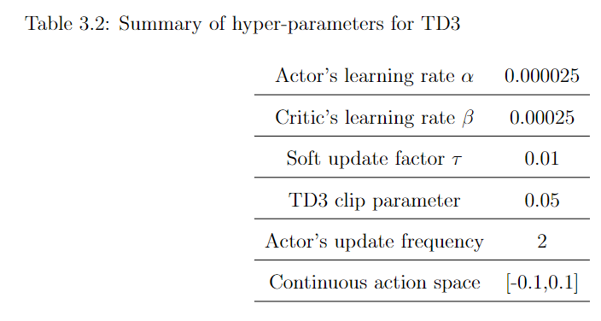
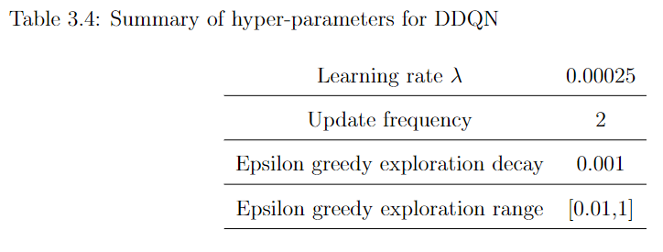
Implementation Details
Introduction(2~4)
Conclusion(37,38)
Questions
Result(28~36)
Objective(5~8)
Method(9~27)
Notes:
Now we move to implementation details.
For actor-critic, we have different learning rates. The one we use for the actor is 10 times smaller than the critics. In TD3, we also update the critics more frequently. By doing so, we shall have the latest and most accurate representation of the environment learned by the critics. a smaller learning rate and A lower update frequency are applied to the actor to avoid overestimation.
DDQN only has q network so 1 learning rate.

Slide 28
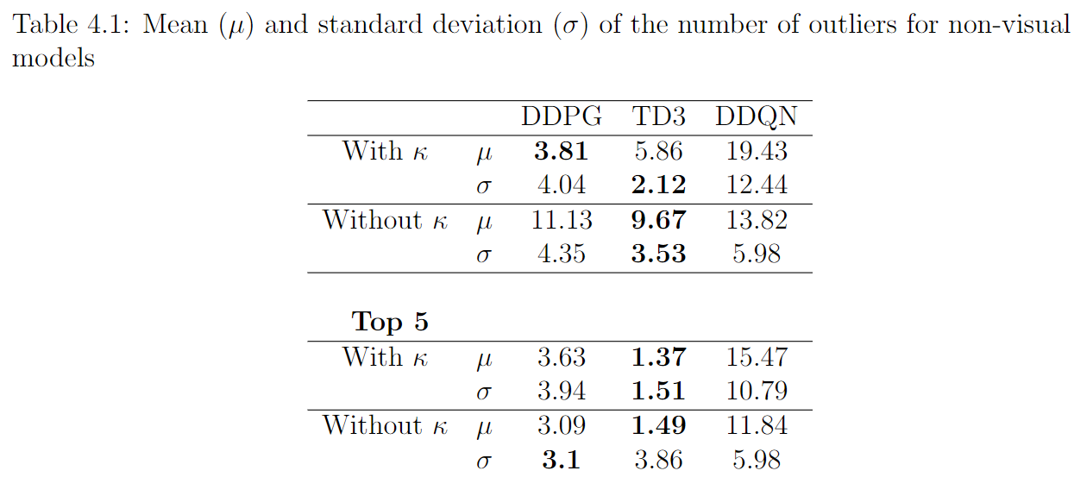
Training Performance – Non-visual Models
Introduction(2~4)
Conclusion(37,38)
Questions
Result(28~36)
Objective(5~8)
Method(9~27)
Notes:
We have finished the methodology section, is there any questions?
From this slide, we will talk about the training performance and evaluation results.
We trained 7 agents for each model and each column stands for one model.
Because some agents failed to learn how to pour and lower the average performance. the top 5 category is included to give us some insights of the upper limit of the algorithms. This fluctuation in performance is common in RL. The agent may never converge due to the wrong exploration direction.
We define a success to be the number of outlier less than 5%, which usually means 2 to 3 outliers. As shown in the table, using kappa generally results in a better performance.
TD3 is able to pour very accurately in general. Using kappa helps reduce the standard deviation noticeably. That means the agents have a consistent good performance. DDPG has a moderate performance and DDQN fail to learn how to aim and pour
****
, for example, it always choose to move up when the right choice is going down. This is totally possible because the exploration is done by using random.

Slide 29
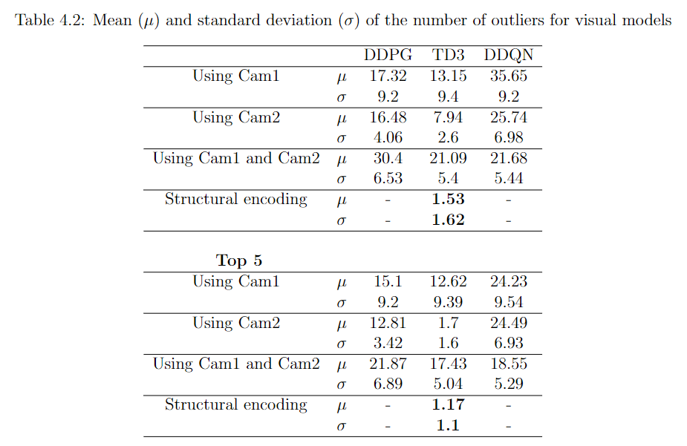
Training Performance - Visual Models
Introduction(2~4)
Conclusion(37,38)
Questions
Result(28~36)
Objective(5~8)
Method(9~27)
Notes:
For visual models, Using depth map doesn’t contribute to better performance, even in the top 5. On the other hand, using cam2 alone can result in good performance in TD3 models. Other algorithms failed to learn the complex visual representation.
Surprisingly, Structural encoding model yields the best performance. It is able to efficiently avoid spillage and the performance is robust. As we can see, the number of outliers from 7 agents are even better than the top 5 agents using cam2.

Slide 30
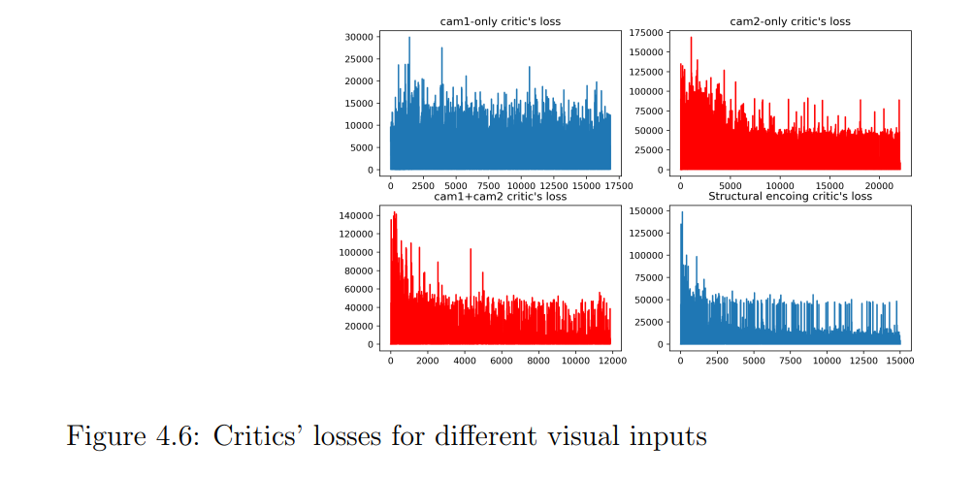
Training Performance – Loss Histogram
Introduction(2~4)
Conclusion(37,38)
Questions
Result(28~36)
Objective(5~8)
Method(9~27)
Notes:
This chart reveals whether the learning progress was smooth or had reached convergence. It doesn’t indicate how good the agent is. A smoother and decreasing loss like this one indicates that the agents were converging to some points and the risks of overshooting was low.
On the other hand, a noisy and fluctuating loss, such as cam1-only model, could be a sign of overfitting such that the gradient at each step was large due to the biased weights. By combine the Figure with previous Table, we can confirm that our agents can’t efficiently solve the task when using Cam1 which is the depth camera
That is because depth map itself doesn’t provide details of landing location. It only provides some hints of where it should land. For human experts, they may have some clues when they see certain structures of the pouring contents and predict the pouring trajectory, that is many bartenders are doing when making cocktails. They only need to look once and then do some showoff tricks while making sure there will be no spillage. But this skill is too hard for the agents to learn.
In term of input sizes, remember that depth map is an array with 256 element, it maybe too large for our simple networks to handle. the cross-section returns a 7-element array while κ is just a scalar. The latter two can pack information more efficiently and not overfit the models.
***
On the other hand, Cam2 provides learnable location representation. If the bounding box is in the middle, then the objects should land inside the target container, and vice versa.

Slide 31
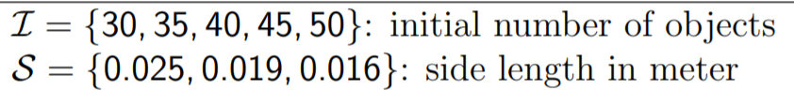
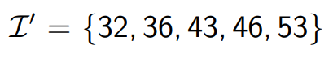
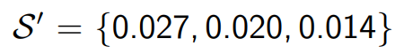
Evaluation - Setup
Randomization:
Model Selection:
Visual models
Cam2 models
Structural Encoding models
Non-visual models with κ
Introduction(2~4)
Conclusion(37,38)
Questions
Result(28~36)
Objective(5~8)
Method(9~27)
Notes:
Coming the evaluation part, We continually using the training setting. The purpose is to see how good our model generalized. We change the random seed during evaluation to make sure agents received different noises. Testing setting are shown in I prime and S prime
We only select three models that have the best performance for evaluation. Furthermore, in order to show the best performance, we selected the agents that have the smallest number of outliers as the candidates for each model.
Each evaluation is run for 200 episodes.
*******
There are two reasons. Firstly, they have the best performance and greater chances to generalize to unseen objects. Secondly, due to time and resources constraints, attentions are paid to only the implementations that can solve the problem.

Slide 32
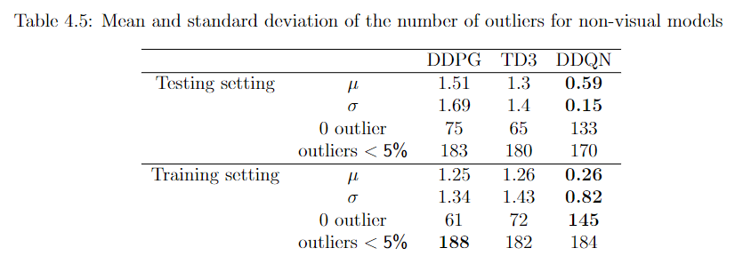
Evaluation – Non-visual Models
Introduction(2~4)
Conclusion(37,38)
Questions
Result(28~36)
Objective(5~8)
Method(9~27)
Notes:
For non-visual settings, all agents have good result. Especially, DDQN has an amazing outcome, where the average number of outlier is less than 1. However, we trained around 50 agents and there is only one such agent exists for Double DQN, the rest are terrible.
Nonetheless, Our proposed method is able to accomplish the search task and produce success rates more than 90% even with unseen objects. The ability of performing the task without visual inputs makes our models robust.
***
When outliers are less than 5% of the pouring content, we call it a success.
when we tried to record demos using the DDQN model, we saw many trials that have more than 5 outliers, some even reaching the number of 10. So the results are only statistically good.

Slide 33
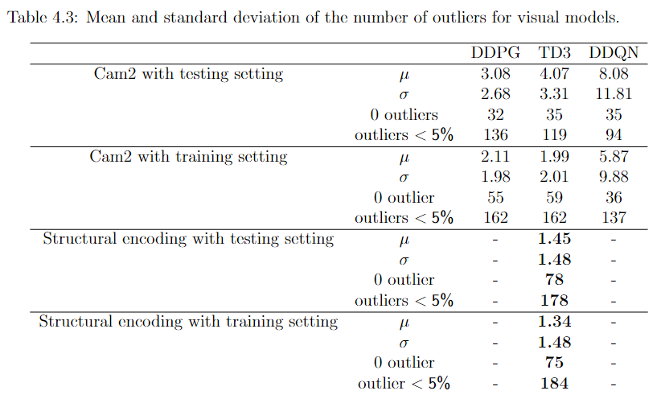
Evaluation - Visual Models
Introduction(2~4)
Conclusion(37,38)
Questions
Result(28~36)
Objective(5~8)
Method(9~27)
Notes:
The result for non-visual models are better than visual models in terms of the average number of outliers. But it is not fair to compare them. Because non-visual model doesn’t change the rotation speed and they are solving different MDP problems. Nevertheless, both results are still very good.
For cam2 models, they perform well in unseen objects. The decay in the performance is acceptable, we basically have 1 to 2 more outliers
Structural encoding model still perform the best. It maintains a consistent performance in both settings,

Slide 34
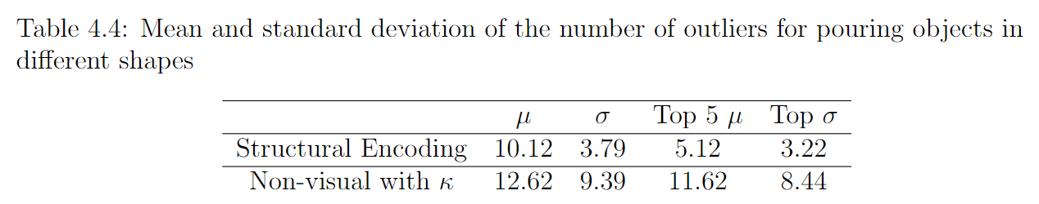
Pouring Different Shapes
Pouring contents: cuboids, spheres, cylinders
κ helps reduce the bias but not the variance
Visual information contribute to a better performance
Introduction(2~4)
Conclusion(37,38)
Questions
Result(28~36)
Objective(5~8)
Method(9~27)
Notes:
To study whether the proposed approach can generalize to different shapes of objects, we apply the structural encoding model and non-visual model directly on these objects.
We can see the average number of outliers is larger than our definition of success. However, it still manages to avoid some spillage by pouring the majority of the content into the target.
****
But if we want to copy the success in pouring cubes, we need to use other metric for structural information.

Slide 35
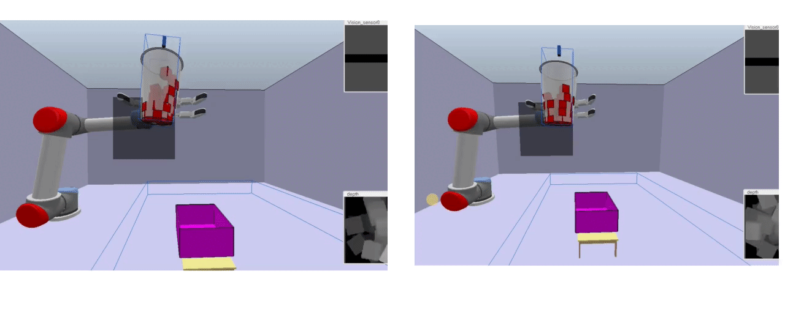
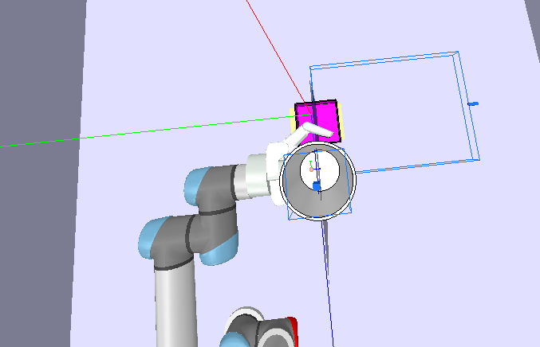
Demo: Non-agent control VS Non-visual Model
Pouring 35 cubes with fixed rotation velocity
Not controlled by the agent(left) Controlled by the non-visual agent(right)
Introduction(2~4)
Conclusion(37,38)
Questions
Result(28~36)
Objective(5~8)
Method(9~27)
Notes:
Now let’s checkout some demos. First is the fixed velocity setting. Both trials have the same start position.
On the left, we pick a position base on our experience. The rim of the pouring cup is next to the rim of the target. It looks like a good position until the second before the content fails out
On the other jif. The agent finds the optimal position and pours steadily from there.

Slide 36
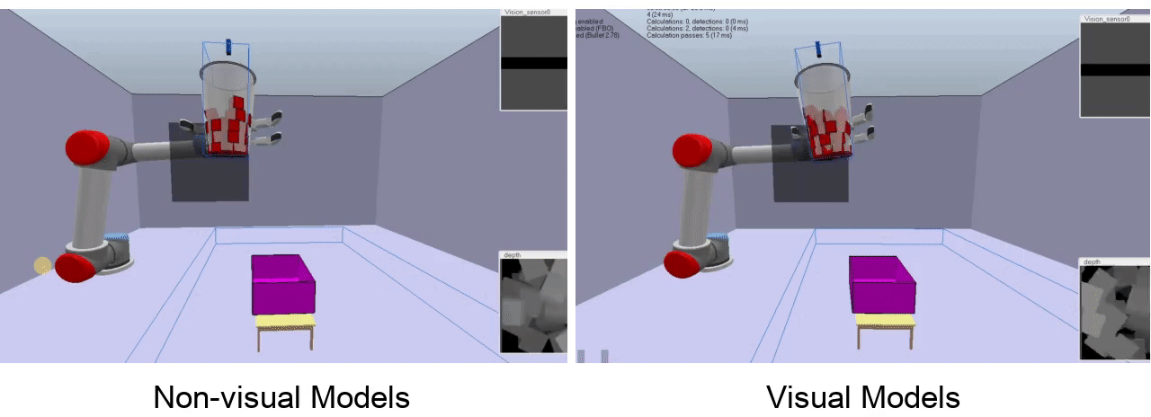
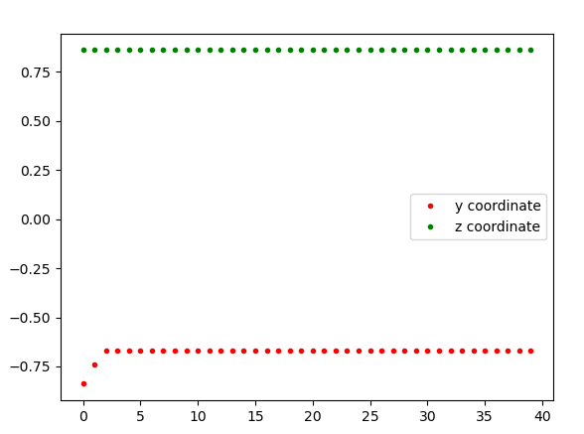
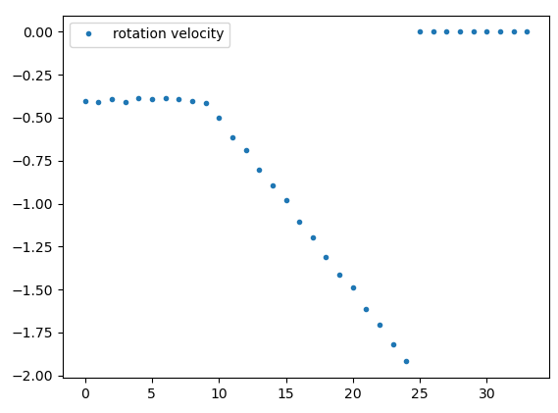
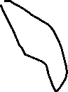


Demo: Non-visual Model VS Visual Model
10s 7s
Introduction(2~4)
Conclusion(37,38)
Questions
Result(28~36)
Objective(5~8)
Method(9~27)
Notes:
Here we compare visual and non-visual models. Both of them are able to find the optimal pouring position and successfully poured everything into the target container.
We can see the visual agent finished faster by having a cw acceleration, which will help the objects have a faster descending speed and land in the container.

Slide 37
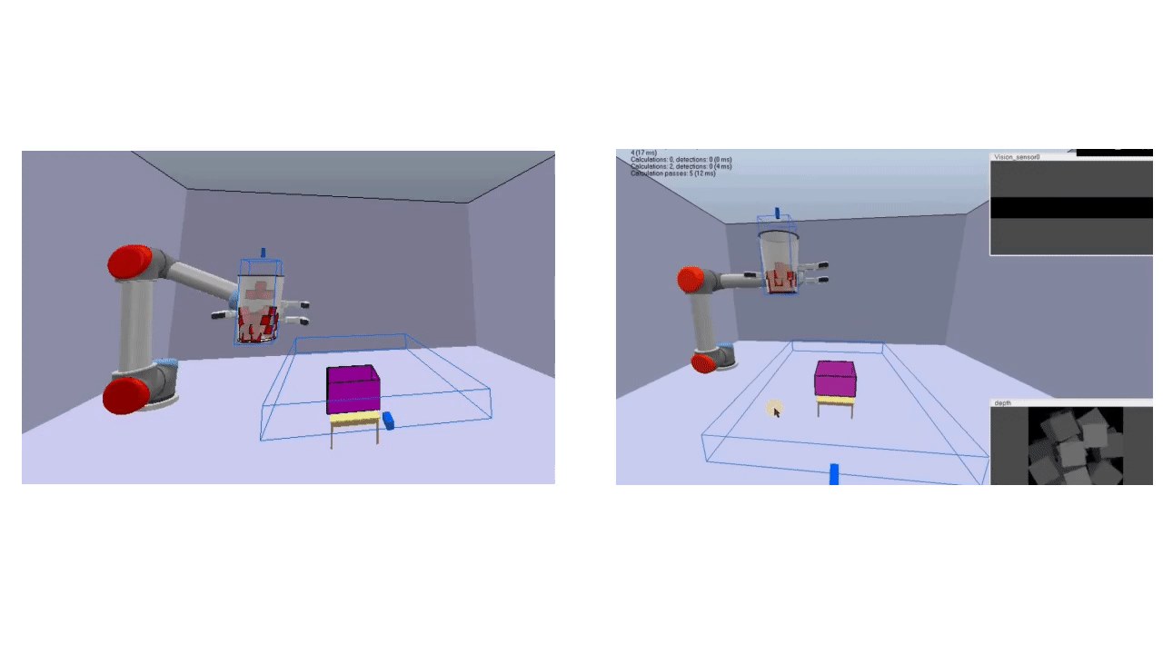
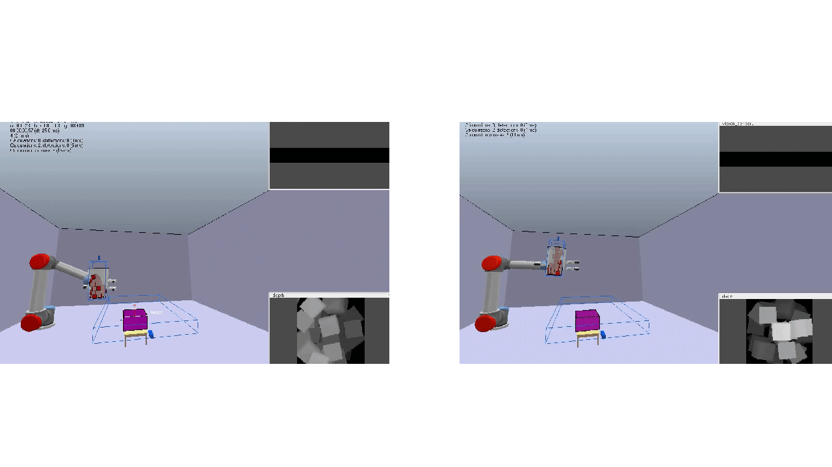
Demo: Random location
Non-agent Non-visual Model(top) & Visual Model(bottom)
Introduction(2~4)
Conclusion(37,38)
Questions
Result(28~36)
Objective(5~8)
Method(9~27)
Notes:
Here we have random starting locations. On the left we don’t control the motion and on the right, we have non-visual model on the top, visual model on the bottom. We can see our proposed method still pour accurately into the target even with different starting positions.

Slide 38
Limitations and Future Development
Different objects, flat objects (fried egg), polyhedrons (nuts)
Different pouring containers and target container
Different frictions between objects
Custom pouring amount
Introduction(2~4)
Conclusion(37,38)
Questions
Result(28~36)
Objective(5~8)
Method(9~27)
Notes:
Finally, we are in the conclusion section. Even though we can make the robot aim and pour accurately, our solution is task specific. As shown in slide 34, the model couldn’t pour spheres and cylinders as good as pouring cubes.
due to the time constraint, we didn’t explore the behavior that pouring from different containers or pouring to an exact amount. Right now we are pouring everything out.
Solving them using RL could be very interesting topics.

Slide 39
Conclusion
We propose a reinforcement learning method to control robots to pour solid object with spillage avoidance
The models can accomplish the task with and without visual assistants
Promising future research direction
Pouring objects in different shapes
Pouring to an exact amount
Introduction(2~4)
Conclusion(37,38)
Questions
Result(28~36)
Objective(5~8)
Method(9~27)
Notes:
To sum up, we proposed a method to control robot to aim and pour solid objects. The task can be done successfully with and without visual assistant.
This concludes my presentation. Thank you for your attention

Slide 40
Reference
[1] David Paulius, Yongqiang Huang, Jason Meloncon, and Yu Sun. Manipulation motion taxonomy and coding for robots. In 2019 IEEE/RSJ International Conference on Intelligent Robots and Systems (IROS), pages 5596–5601, 2019.
[2] Yongqiang Huang and Yu Sun. Generating manipulation trajectory using motion harmonics. In 2015 IEEE/RSJ International Conference on Intelligent Robots and Systems (IROS), pages 4949–4954, 2015.
[3] Tianze Chen, Yongqiang Huang, and Yu Sun. Accurate pouring using model predictive control enabled by recurrent neural network. In 2019 IEEE/RSJ International Conference on Intelligent Robots and Systems (IROS), pages 7688–7694, 2019.
[4] Yongqiang Huang and Yu Sun. Learning to pour. In 2017 IEEE/RSJ International Conference on Intelligent Robots and Systems (IROS), pages 7005–7010. IEEE, 2017.
[5] Juan Wilches, Yongqiang Huang, and Yu Sun. Generalizing learned manipulation skills in practice. In 2020 IEEE/RSJ International Conference on Intelligent Robots and Systems (IROS), pages 9322–9328, 2020. [6] Chau Do, Camilo Gordillo, and Wolfram Burgard. Learning to pour using deep deterministic policy gradients. In 2018 IEEE/RSJ International Conference on Intelligent Robots and Systems (IROS), pages 3074–3079. IEEE, 2018.
[7] Homayoun Moradi, Mehdi Tale Masouleh, and Behzad Moshiri. Robots learn visual pouring task using deep reinforcement learning with minimal human effort. In 2021 9th RSI International Conference on Robotics and Mechatronics (ICRoM), pages 504–510, 2021.
[8] Timothy P Lillicrap, Jonathan J Hunt, Alexander Pritzel, Nicolas Heess, Tom Erez, Yuval Tassa, David Silver, and Daan Wierstra. Continuous control with deep reinforcement learning. arXiv preprint arXiv:1509.02971, 2015.
[9] Scott Fujimoto, Herke Hoof, and David Meger. Addressing function approximation error in actor-critic methods. In International Conference on Machine Learning, pages 1587–1596. PMLR, 2018.
[10] Hado Van Hasselt, Arthur Guez, and David Silver. Deep reinforcement learning with double q-learning. In Proceedings of the AAAI conference on artificial intelligence, volume 30, 2016
[11] https://github.com/wangshusen/DeepLearning

Slide 41
Questions?
Discussed topics in today’s presentation
Pouring problem formulation
MDP tuple
Environment setup
Reinforcement learning algorithm
Algorithm selection
MDP elements
Visual model’s architecture, Structural encoding model’s architecture, non-visual model’s architecture,
Implementation
Results
Introduction(2~4)
Conclusion(37,38)
Questions
Result(28~36)
Objective(5~8)
Method(9~27)
Notes:
To sum up, we proposed a method to control robot to aim and pour solid objects. The task can be done with and without visual assistant and the performance is outstanding.
This concludes my presentation. Thank you for your attention

Slide 42
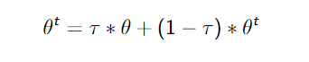
Full Implementation Detail
Soft update: τ = 0.01
Layer 1: 400 neurons
Layer 2: 300 neurons
Layer weights initialization: Uniform distribution
Hidden layer activation function: RELU
Critics output layer activation function: linear
Actor output layer activation function: tanh
One Step: a composition of 10 time step in Coppelia

Slide 43
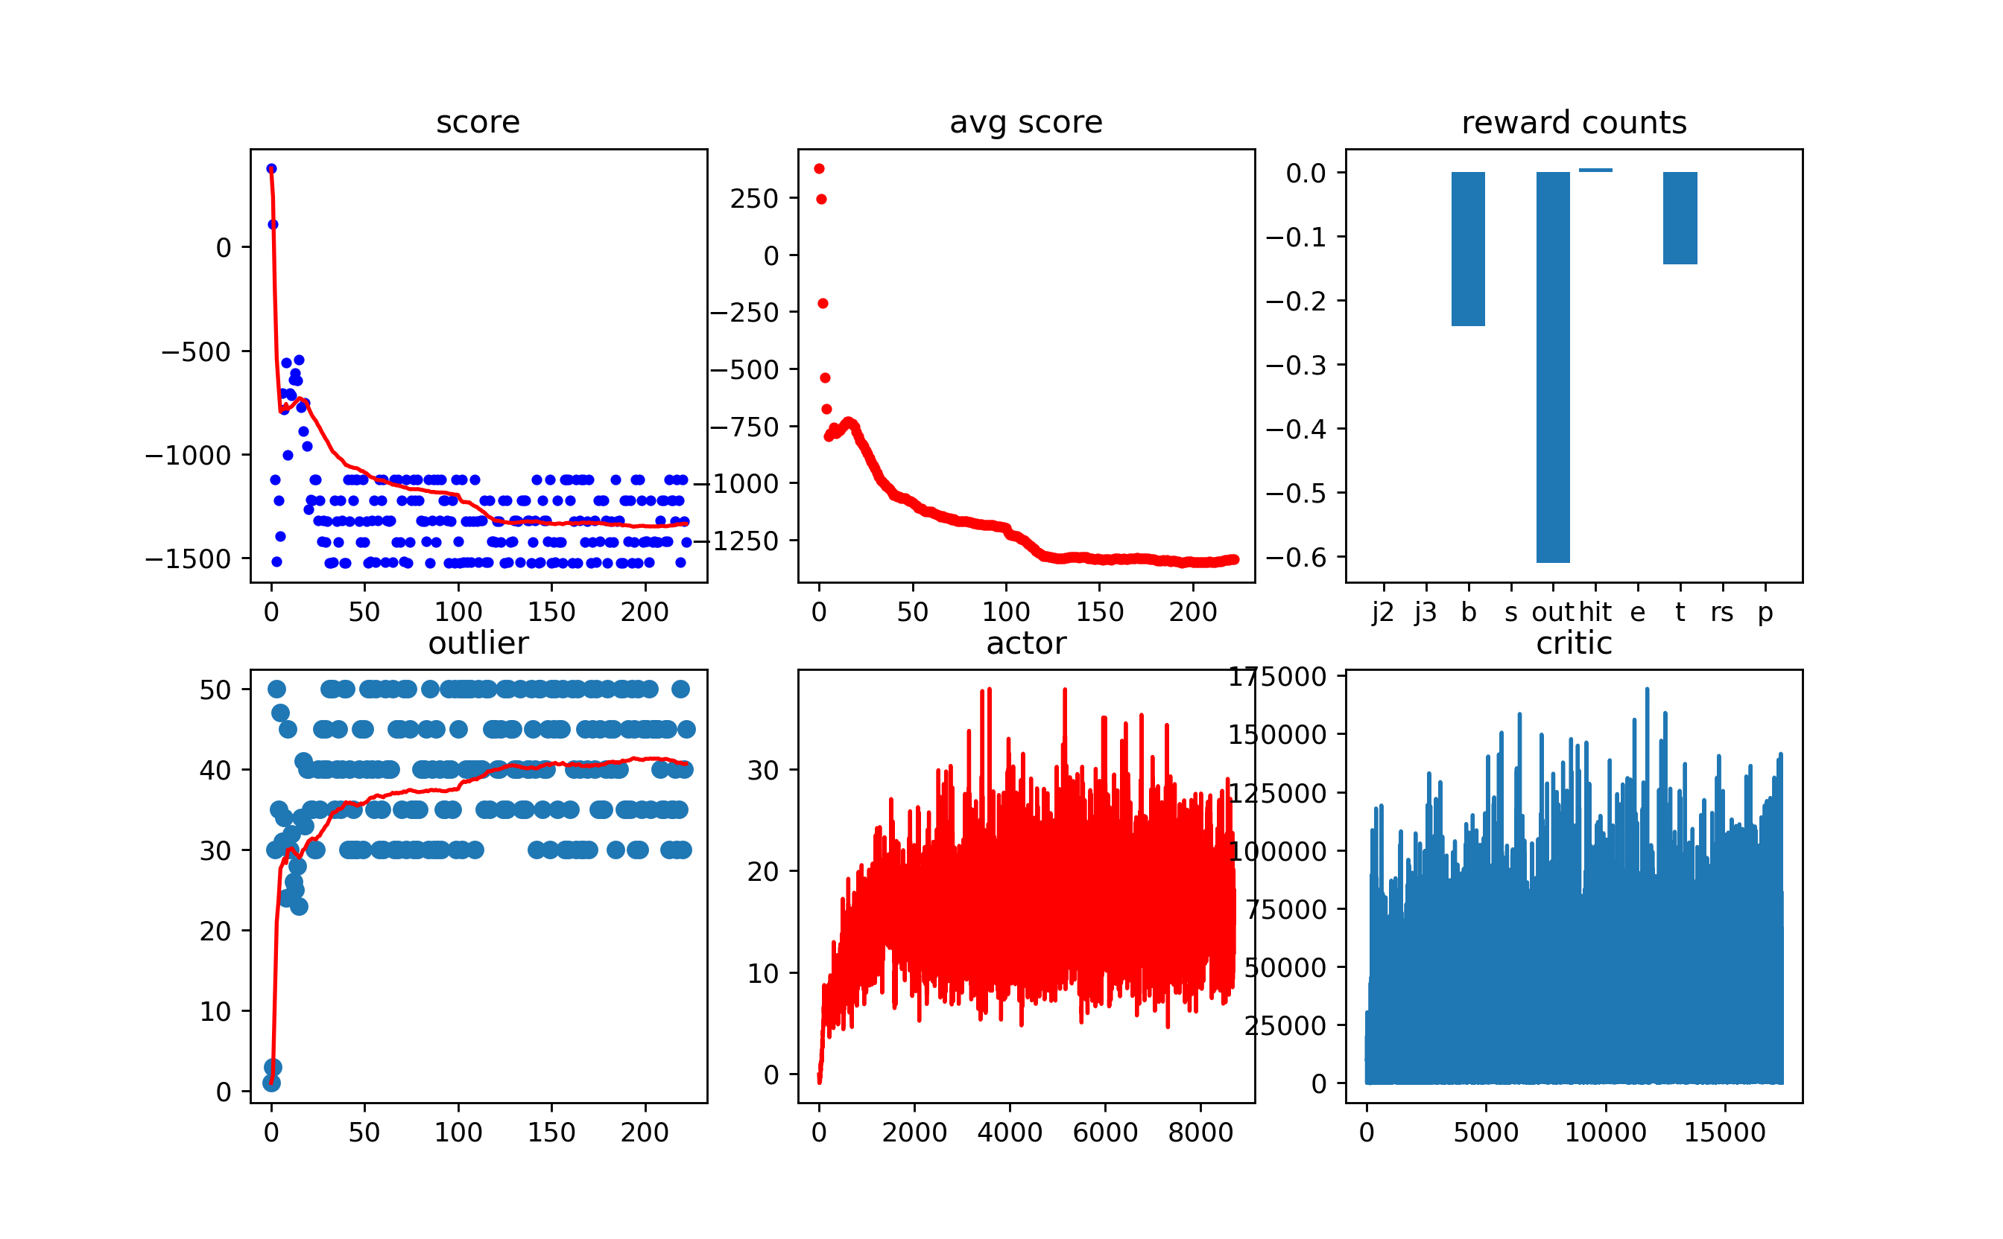
Failed to Reach Convergence
Not bounded workspace

Slide 44
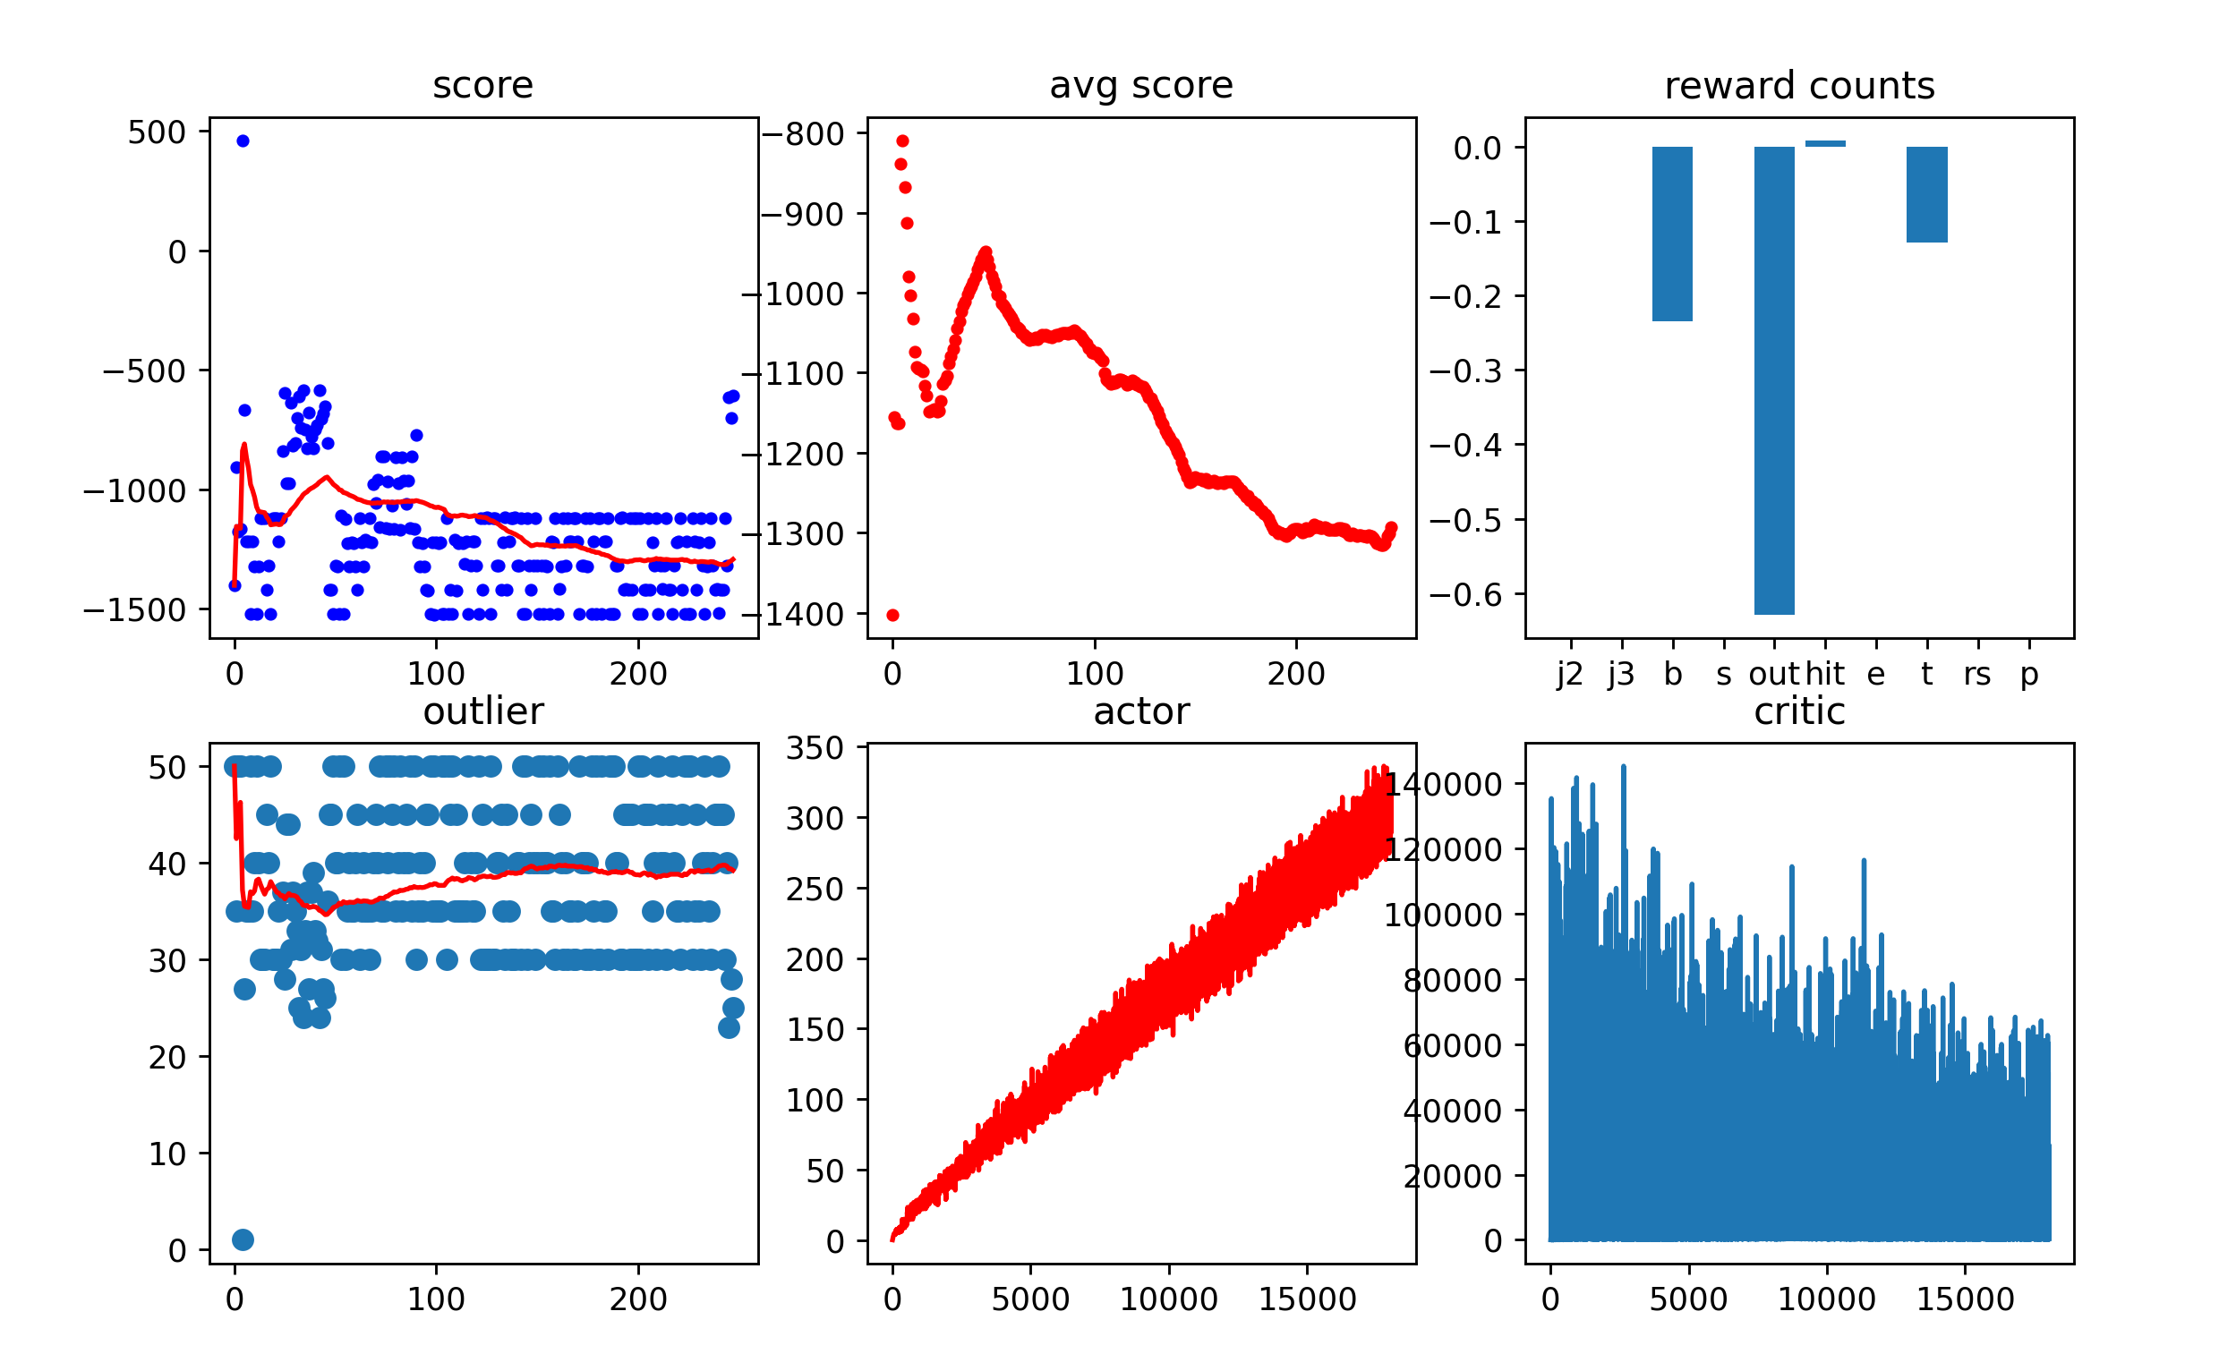
Failed to Reach Convergence
Not bounded action

Slide 45
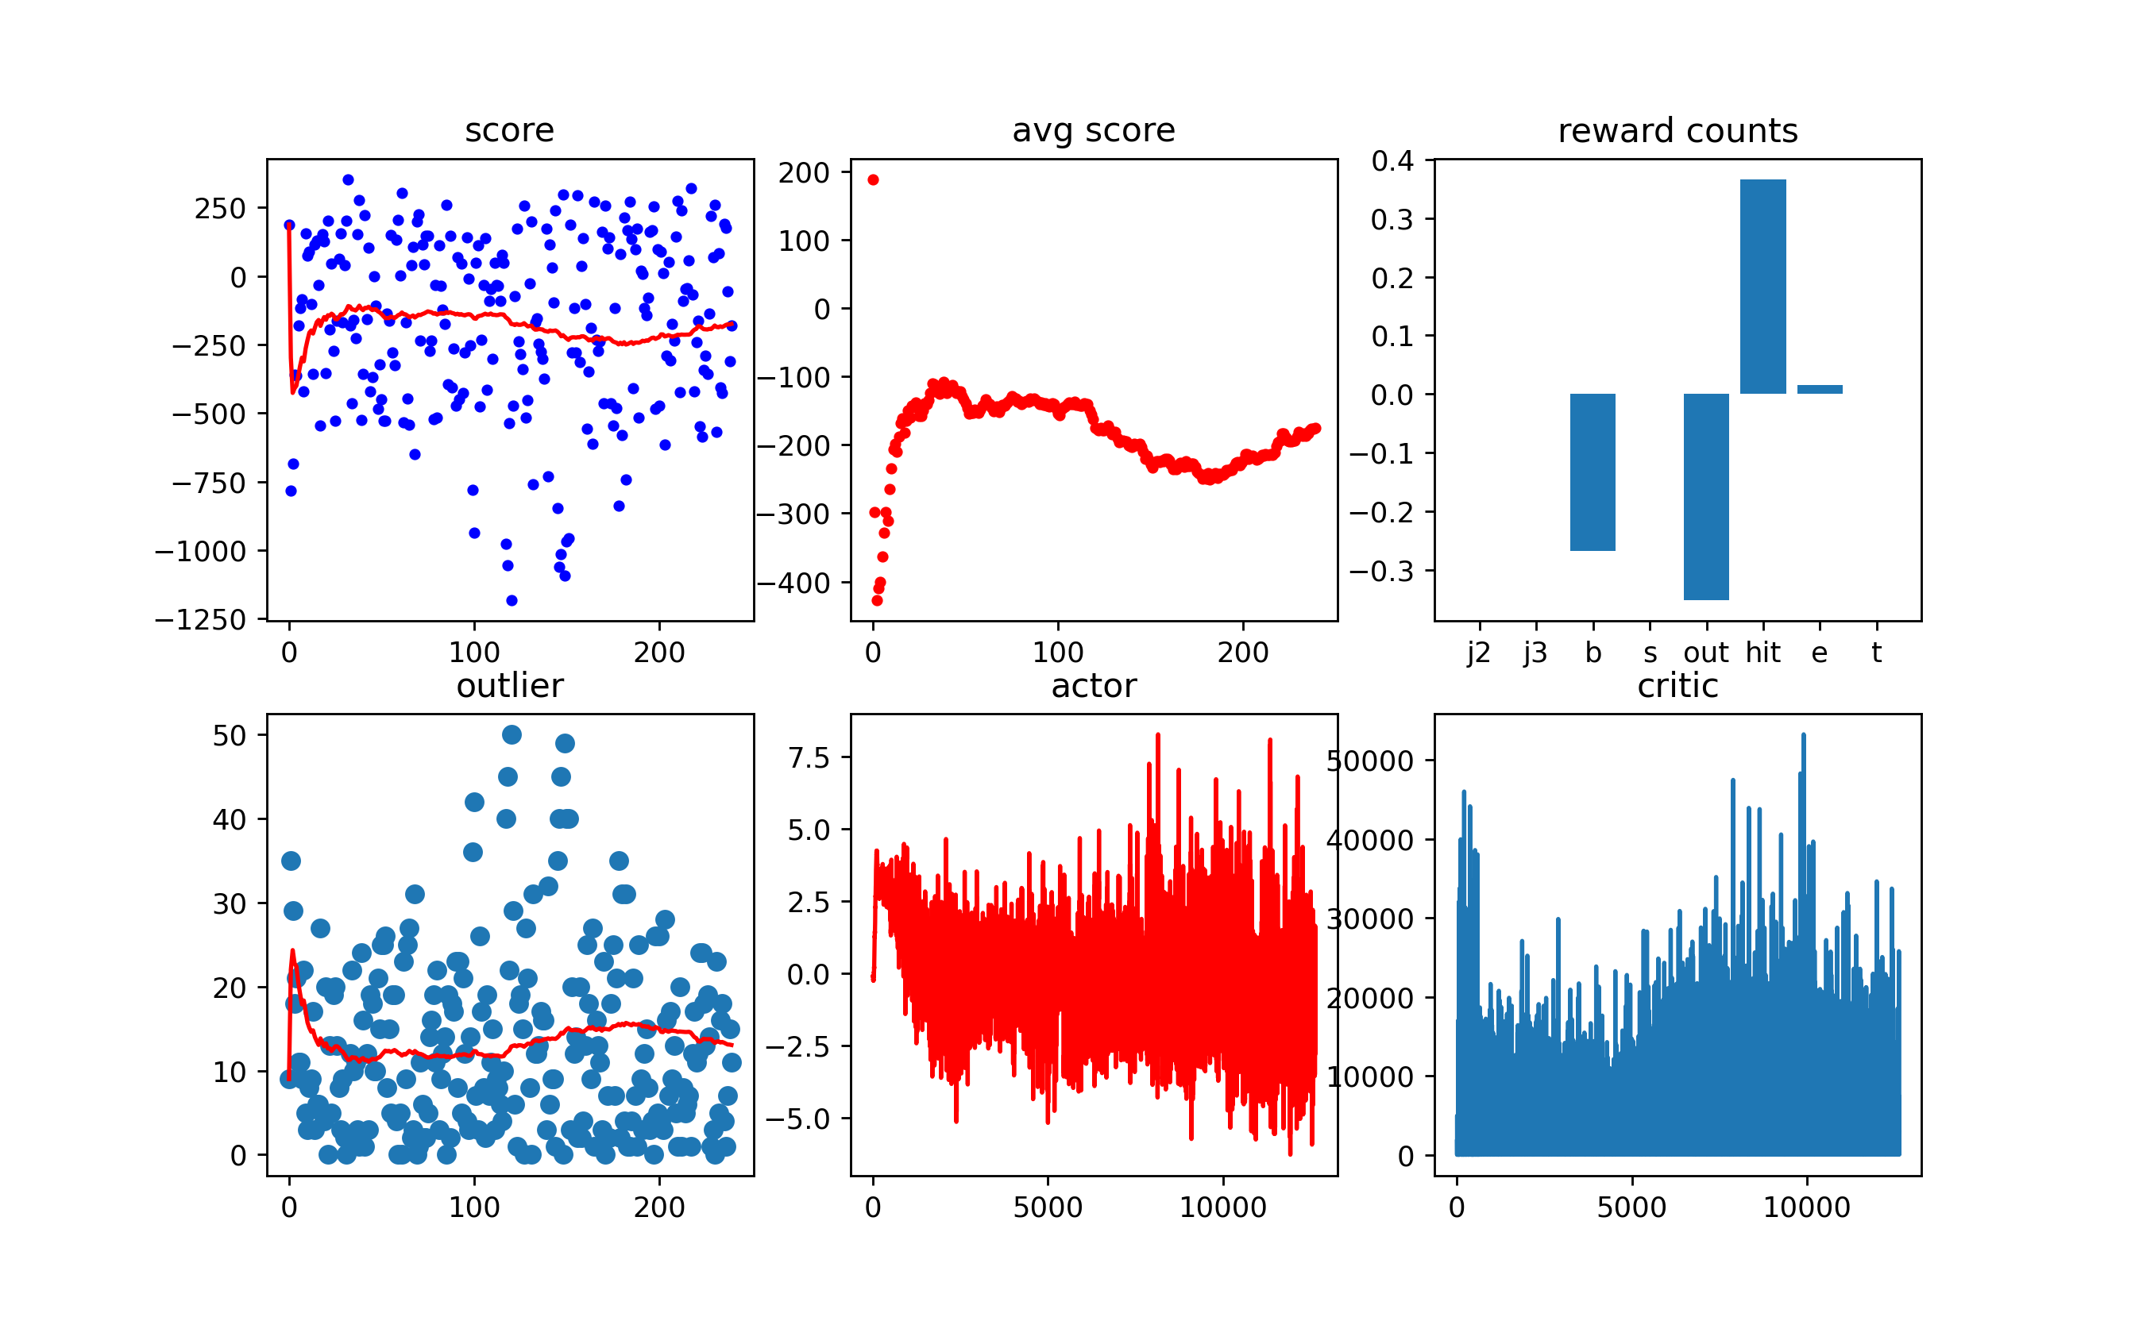
Failed to Reach Convergence
Using cam1
Notes:
1642434830

Slide 46
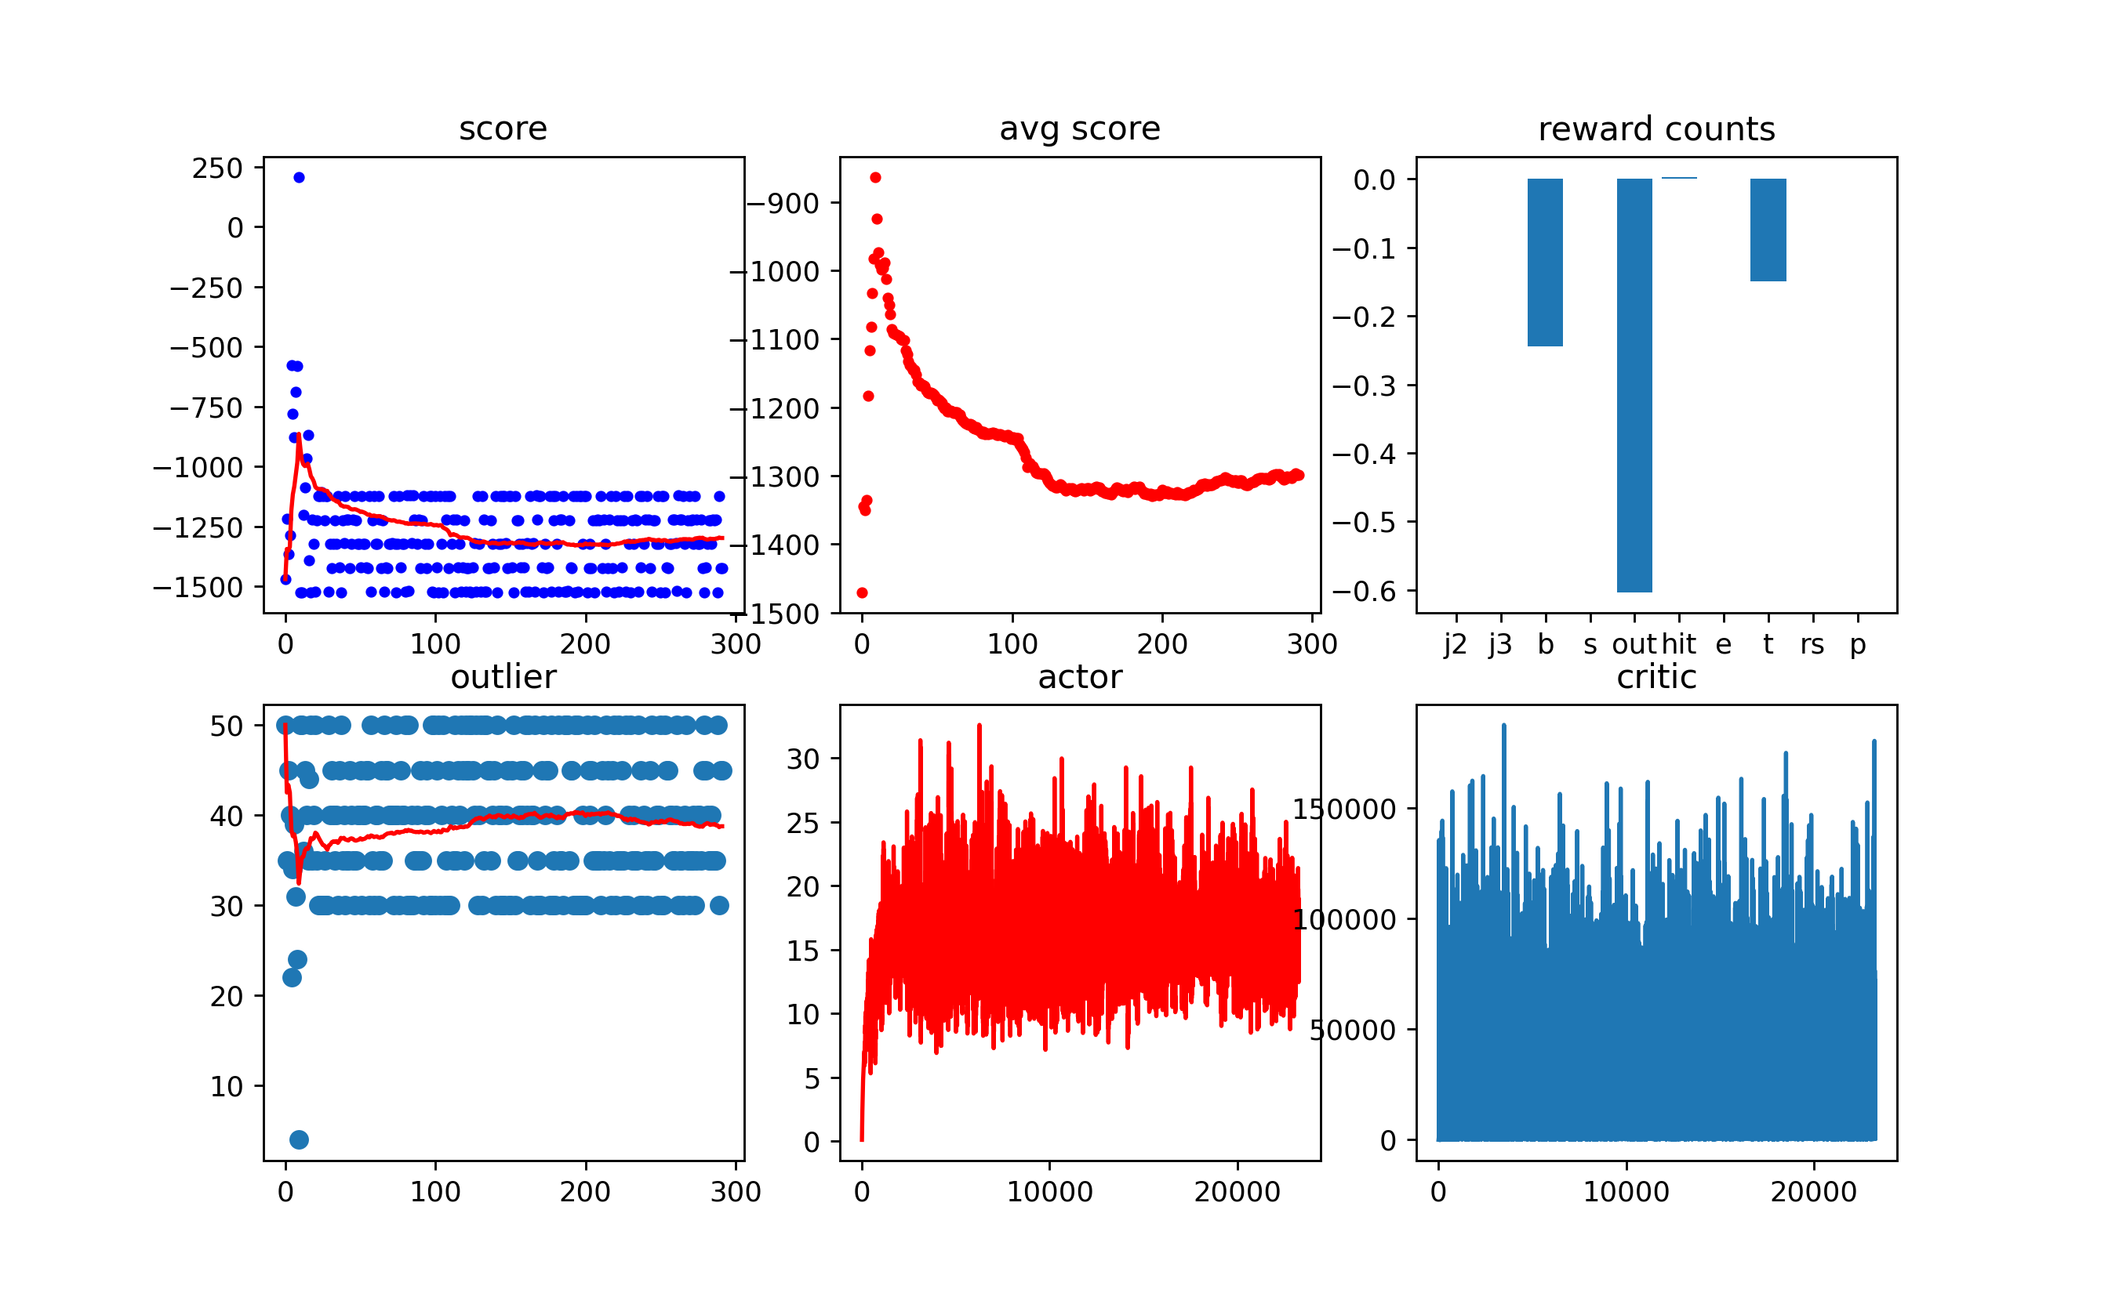
Failed to Reach Convergence
Non-visual model without kappa
Notes:
1642434830

Slide 47
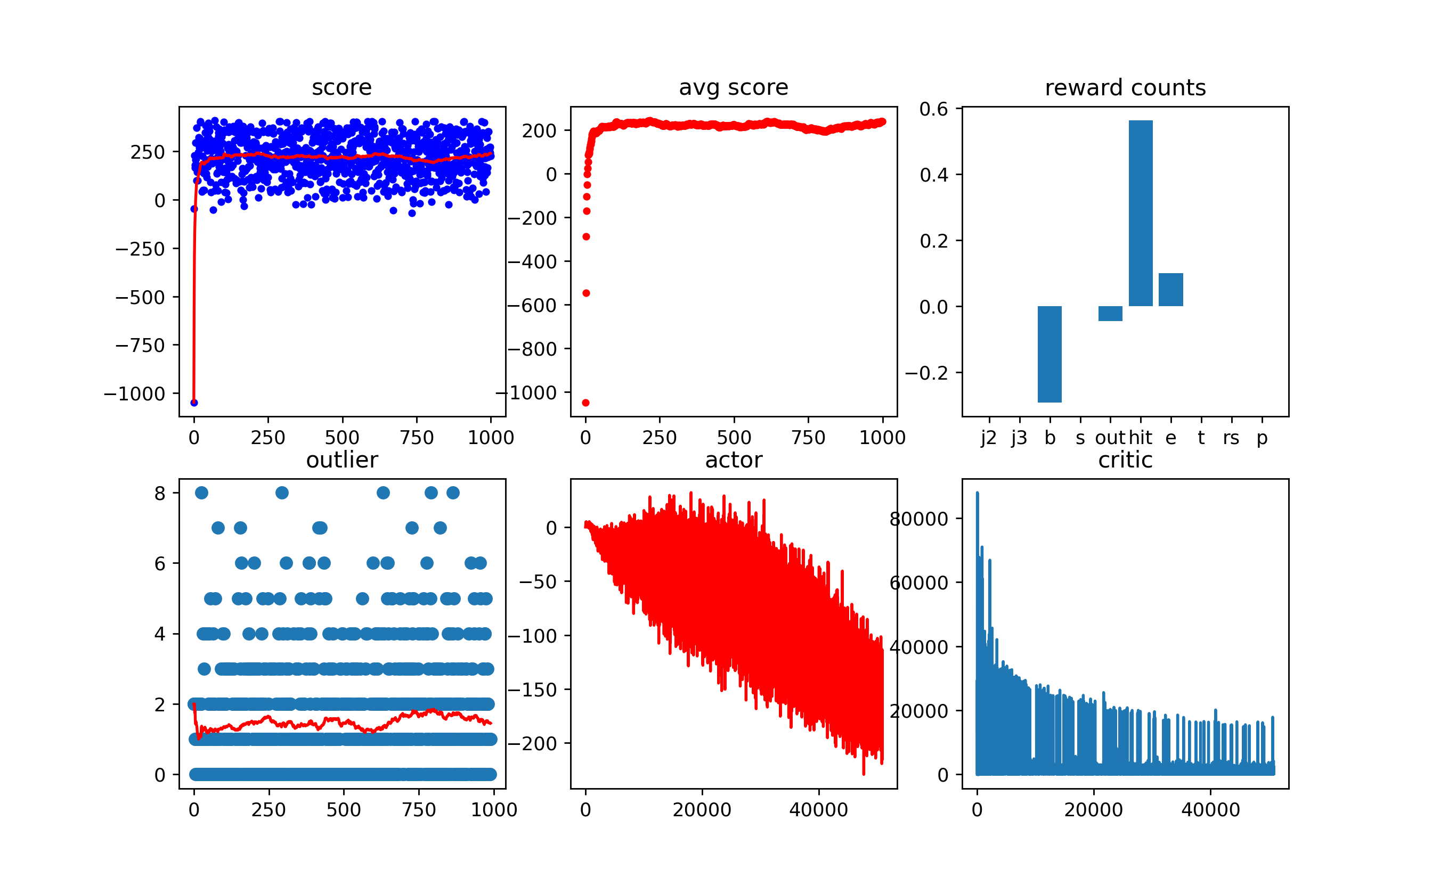
Training Instance Example

Slide 48
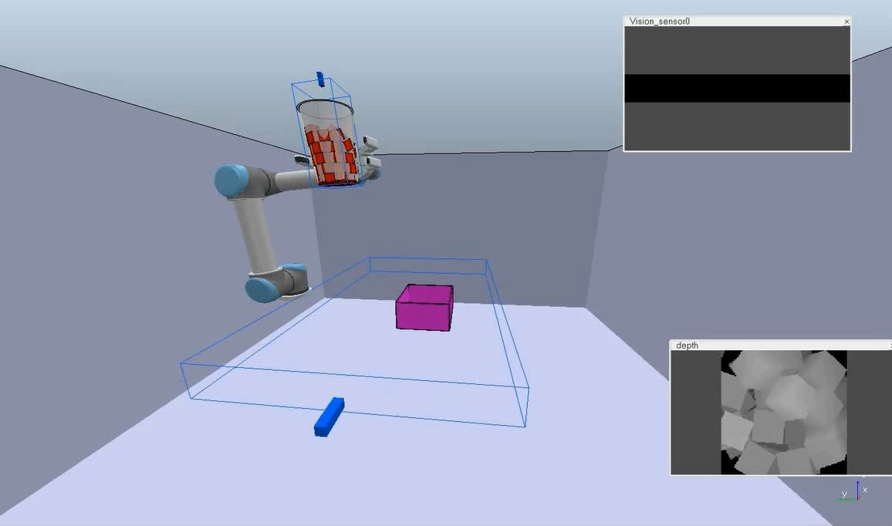
Demo: unnecessary movement
5X
Introduction
Conclusion
Questions
Objective
Method
Result

Slide 49
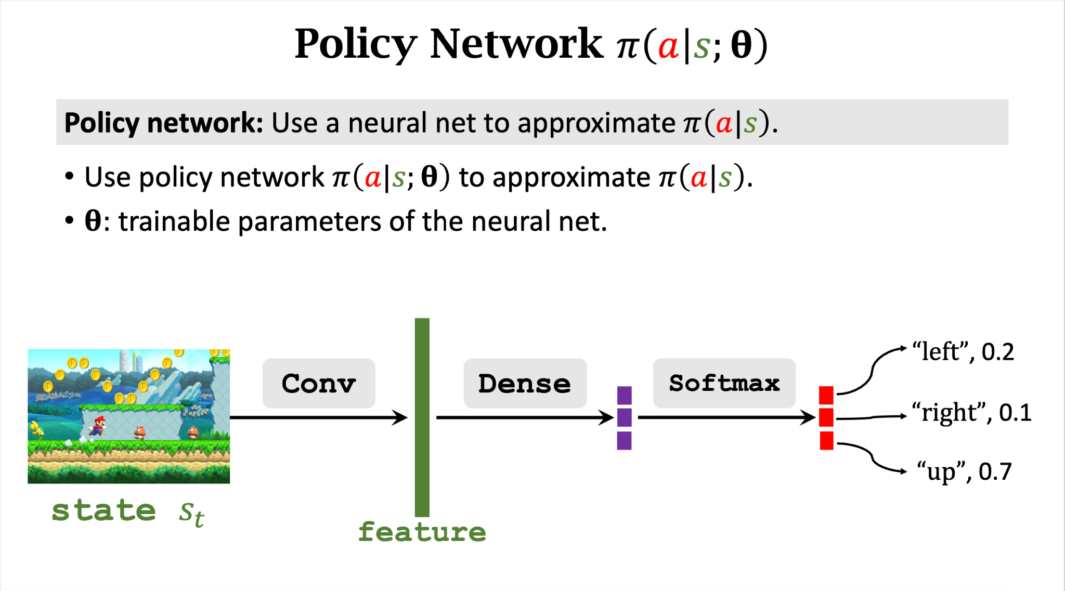
Slide credit: Shusen Wang
Introduction
Conclusion
Questions
Objective
Method
Result

Slide 50
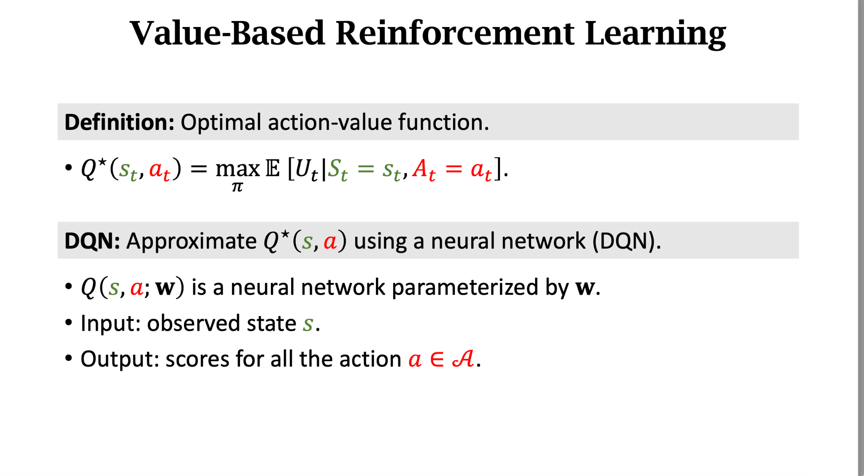
Slide credit: Shusen Wang
Introduction
Conclusion
Questions
Objective
Method
Result

Slide 51
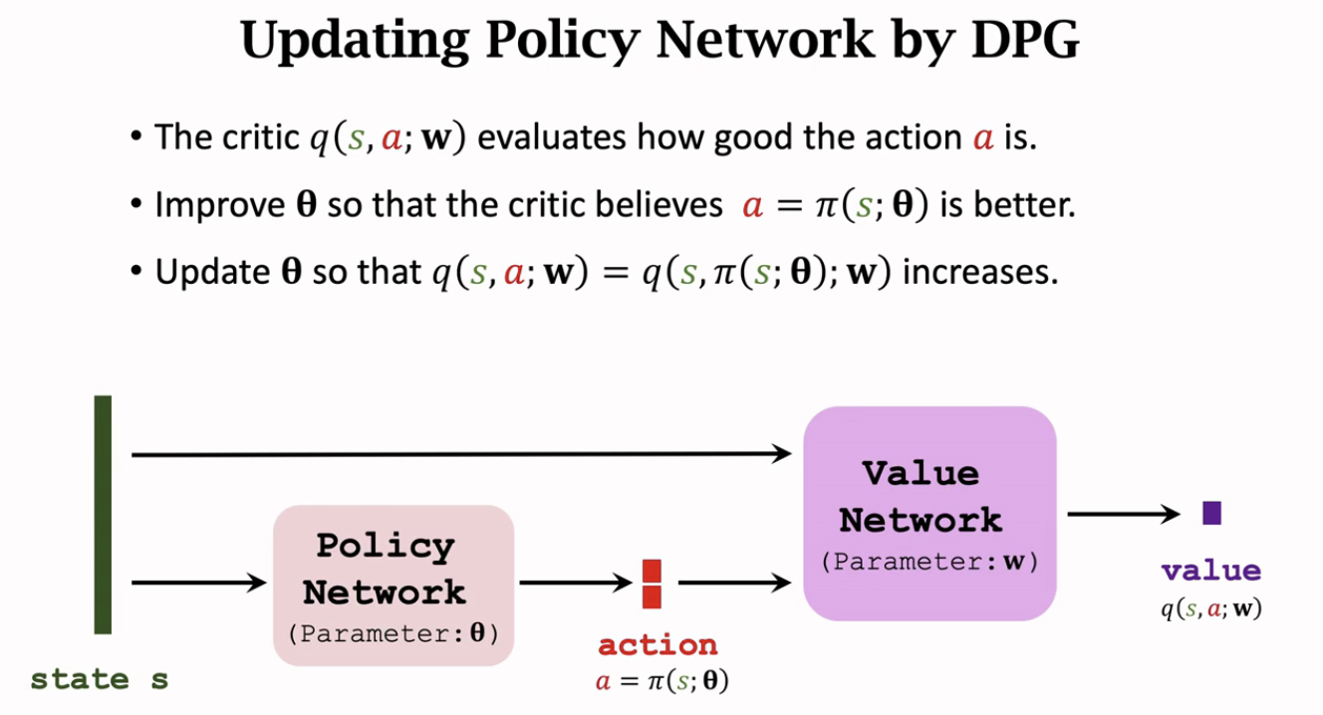
Slide credit: Shusen Wang
Introduction
Conclusion
Questions
Objective
Method
Result

Slide 52
Why making the workspace small
Temporal-Logic-Based Reward Shaping for Continuing Reinforcement Learning Tasks
Batch Exploration with Examples for Scalable Robotic Reinforcement Learning
Learning Deep Neural Policies with Stability Guarantees
Accelerating Robotic Reinforcement Learning via Parameterized Action Primitives
Living Object Grasping Using Two-Stage Graph Reinforcement Learning
Why only yz
Faster convergence, mimic human behavior
What is the point to have visual model if non-visual is so good
Using visual input is a classic solution in robotics. Because human can’t perform most of the tasks without vision, it is natural to try to solve a task with robot using vision. But our method provides a solution that works without vision. This makes our method cheaper and more robust.
Why kappa is only fed to the actor while cross section is fed to both
Cross section is one of the input state so by the definition of RL, it has to be fed to both. Kappa is an auxiliary term for improving the performance
Notes:
People limited the workspace, reward shielding, predefined primitives to speed up, or just make the problem solvable
Exploration can bring many unexpected outcomes. To develop a good exploration strategy itself can be a publication. So most people just cut off the workspace and only allow the agents to work within the boundary. There is a tradeoff between potential global optimal that is outside of the perimeter, and fast and mostly guaranteed convergence.

Slide 53
Why acceleration in slide 36 is a good thing
If the speed is not an extreme, the falling stream will be narrower, especially for cubes. When I try to pour wooden cube, and collecting data for another paper, cube will not come out one by one. The slower I go, the more outliers I have, because of the static friction. But if I dump it, the chance of getting outliers is small.
Why use training setting
In reinforcement learning, we don’t actually have the split train/eval/test. As long as the MDP elements still represent the environment and action accurately, the model should work no matter what. We define the two settings to see how good our models generate to unseen objects.
Why vision input doesn’t work
In fact, DDPG has a mean number of outlier of 2.41 in the top 4 category in using Cam2.
It does help the agents to some extent. There are two main reasons. First is the fully connected layers can’t extract the information that is helpful for pouring, in other words it is not goal orientated. It may just learn something else, such as the hue or shape of the image. The second reason is mentioned in the slide. The image itself may not have much meaningful information.
Why Kappa helps
Kappa can efficiently indicate the shape of the content, especially we are using cubes. So the MLP for processing kappa can represent the shape without using visual inputs. And because the agents now know what content is in the cup, they can act accordingly.

